Slide 1
2nd week – 3rd Presentation

Slide 2
Weekly report: management team
Week number: 2
Date: 7th/09/2025
Supervisor: Prof. Peter Quell
Group members: Bakhtyar Karim, Federico De Mita, Josef Remberger

Slide 3
List of contents
Benchmark Wind turbines
Commmon industry configuration for 5MW Class
Benchmarks comparsion
Other subsystems of benchmarks
Bakhtyar Karim

Slide 4
1. Benchmark Wind Turbines & Why it matters
Benchmarking means studying existing wind turbines in the market that match our general concept .
Why benchmarks matters?
Helps us learn from proven 5 MW turbine designs used in real world environments
Supports future decisions in further details of drivetrain, tower, and control systems
Reduces risk by aligning with certifiable and manufacturable configurations
Provides technical references for all teams to start concept development
Ensures we follow industry best practices and can justify our design choices
[1], [2], [3]
Bakhtyar Karim

Slide 5
2. Common industry configuration (5 MW Class)
Rated Power: 5–5.7 MW
Rotor Diameter: 145–163 m
Hub Heights: Typically between 100–127 m
Generator Type: Mostly DFIG
Drivetrain Concept: 3 point suspension
Target Wind Class: IEC IIIA, low to moderate wind sites
These configurations are used in modern turbines installed in Turkey, India, Spain, and the Middle East.
[1], [2], [3], [4], [5]
Bakhtyar karim

Slide 6
3. Benchmarks comparsion
Feature | SG 5.0-145 | Nordex N163/5.X | GE Cypress 5.3-158
Rated Power | 5.0 MW | Up to 5.7 MW | 5.3 MW
Rotor Diameter | 145 m | 163 m | 158 m
Hub Height | Up to 127.5 m | 98 / 113 / 118 m | ~90–120 m
Drivetrain | 3 Point Suspension | 3 Point Suspension | 3 Point Suspension
Generator | DFIG | DFIG | DFIG / PMSG
Wind Class | IEC IIIA | IEC IIIA | IEC IIIA
Regions Used | India, Turkey | Turkey, EU, LATAM | Middle East, Asia, Europe
[1], [2], [3]
Bakhtyar Karim

Slide 7
4. Other subsystems of benchmarks
Subsystem | Benchmark Approach | Example Turbines
Yaw System | Active yaw drives, flange mount | SG 5.0-145, Nordex N163, GE Cypress
Pitch System | Electric pitch motors | Nordex N163, GE Cypress
Nacelle Design | Modular serviceable structure | GE Cypress
Main Bearings | Journal or spherical types | SKF, ORE Catapult pilot turbines
Lidar Integration | Forward looking lidar for preview control | Siemens, Vestas (LAC systems)
Control System | ROSCO, feedforward & feedback hybrid | IEA RWTs, open source platforms
Grid Interface | DFIG with fault ride through capabilities | Nordex Delta4000, Siemens DFIG
Simulation Tools | OpenFAST, PowerFactory, Simulink | DTU, NREL, IEA Benchmark Turbines
[1], [2], [3], [4], [6], [7], [8]
Bakhtyar karim

Slide 8
Bibliography – Managment team - PM
[1] Siemens Gamesa Renewable Energy, “SG 5.0-145 Onshore Wind Turbine,” Siemens Gamesa, [Online]. Available: https://www.siemensgamesa.com/en-int/products-and-services/onshore/wind-turbine-sg-5-0-145. [Accessed: Oct. 1, 2025].
[2] Nordex SE, “N163/5.X – Delta4000 Platform,” Nordex Group, [Online]. Available: https://www.nordex-online.com/en/technology/platforms/delta4000/. [Accessed: Oct. 1, 2025].
[3] GE Vernova, “Cypress Platform – 5.3-158 MW Onshore Wind Turbine,” GE Renewable Energy, [Online]. Available: https://www.gevernova.com/. [Accessed: Oct. 3, 2025].
[4] P. Bortolotti, J. J. Jonkman, L. Wang, and A. D. Wright, “IEA Wind TCP Task 37: Systems Engineering in Wind Energy - WP2.1 Reference Wind Turbines,” U.S. Department of Energy, Office of Scientific and Technical Information, May 2019. [Online]. Available: https://doi.org/10.2172/1529216. [Accessed: Oct. 3, 2025].
[5] National Renewable Energy Laboratory (NREL), “NREL 5 MW Reference Turbine Documentation,” [Online]. Available: https://www.nrel.gov/wind/nrel-5mw-reference-turbine.html. [Accessed: Oct. 3, 2025].
[6] NREL, “OpenFAST Documentation Portal,” [Online]. Available: https://openfast.readthedocs.io. [Accessed: Oct. 3, 2025].
[7] NREL, “ROSCO – Reference Open Source Controller,” GitHub Repository, [Online]. Available: https://github.com/NREL/ROSCO. [Accessed: Oct. 3, 2025].
[8] T. Decker, G. Jacobs, J. Röder, et al., “Experimental study on the condition monitoring of planetary journal bearings in wind turbine gearboxes using the surface acoustic wave method,” Forsch. Ingenieurwes., vol. 89, p. 112, 2025. [Online]. Available: https://doi.org/10.1007/s10010-025-00887-y. [Accessed: Oct. 3, 2025].
Bakhtyar Karim

Slide 9
List of contents
Result file
Rotor diameter choice
Why 250 W/m^2

Slide 10
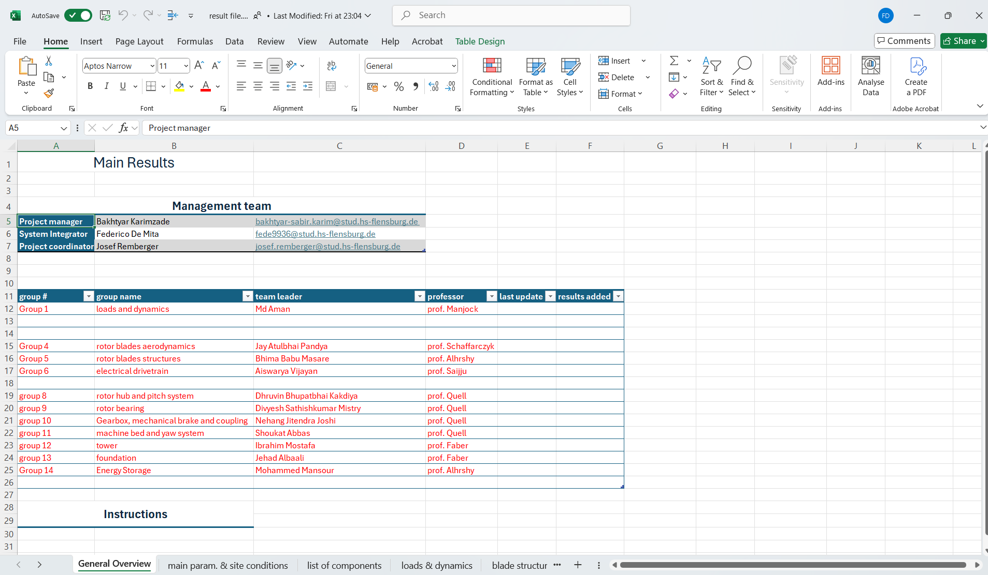
1. Result file
New file created for interfaces between the mechanical groups!!!!
Federico De Mita

Slide 11
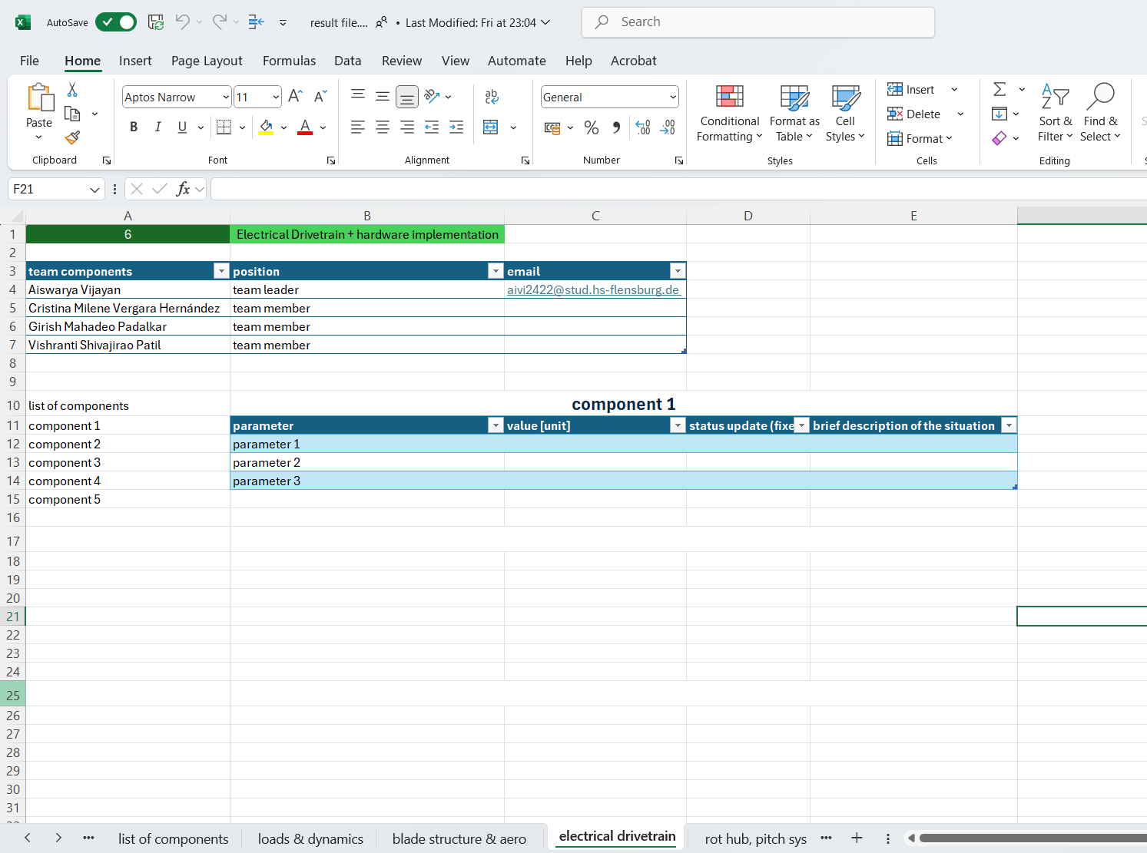
1. Result file
It allows teams to:
Make a record of all their components
Write down and update all the components parameters
Check the situation of other groups
THE FILE WILL BE CONTINOUSLY UPDATED!!!
Federico De Mita

Slide 12
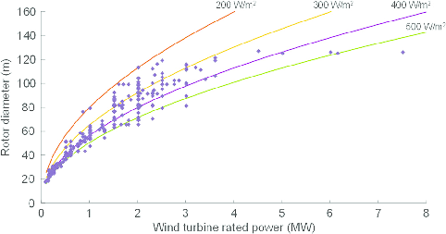
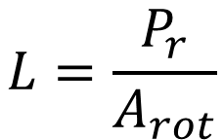
2. Rotor Diameter choice
Market trends
Rotor Loading
(or Specific Power)
$$L=\frac{P_{r}}{A_{rot}}$$
[1]
Federico De Mita

Slide 13
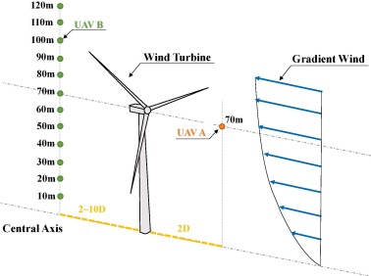
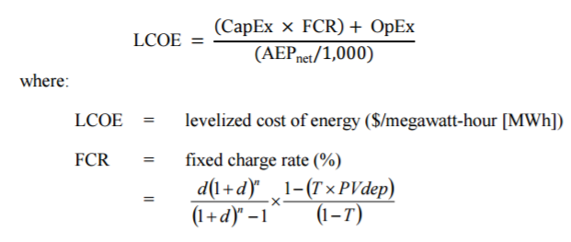
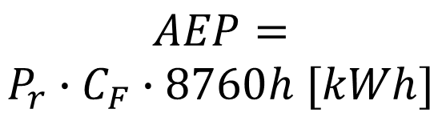
2. Rotor Diameter choice
Why L must be low
Higher capacity factors
High AEP
Low LCOE
$$AEP=$$
$$P_{r}∙C_{F}∙8760h [kWh]$$
Federico De Mita

Slide 14
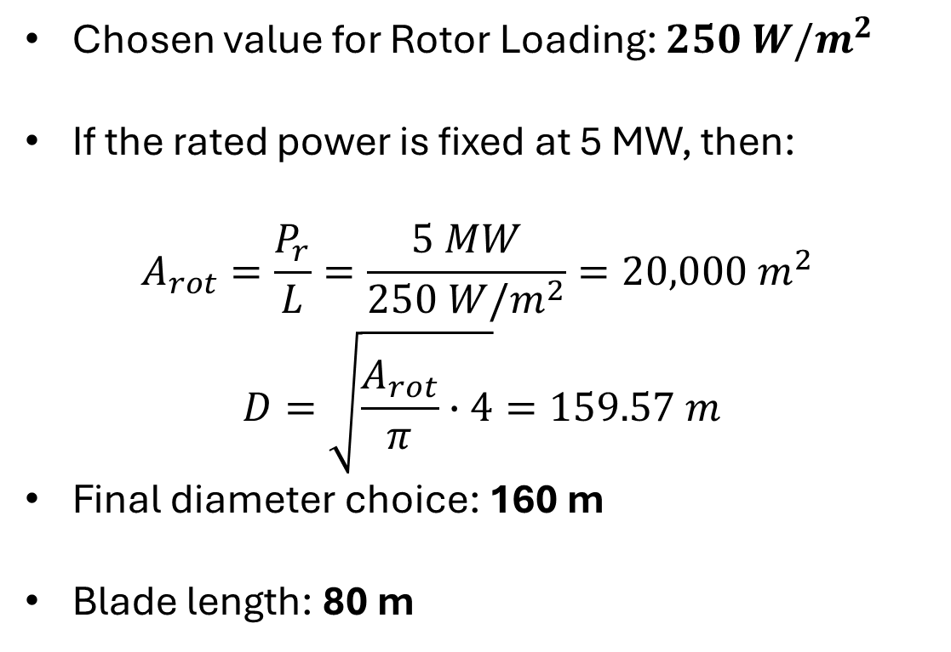
2. Rotor Diameter choice
Chosen value for Rotor Loading: $250 W/m^{2}$
If the rated power is fixed at 5 MW, then:
$$A_{rot}=\frac{P_{r}}{L}=\frac{5 MW}{250 W/m^{2}}=20,000 m^{2}$$
$$D=\sqrt{\frac{A_{rot}}{π}∙4}=159.57 m$$
Final diameter choice: 160 m
Blade length: 80 m
Federico De Mita

Slide 15
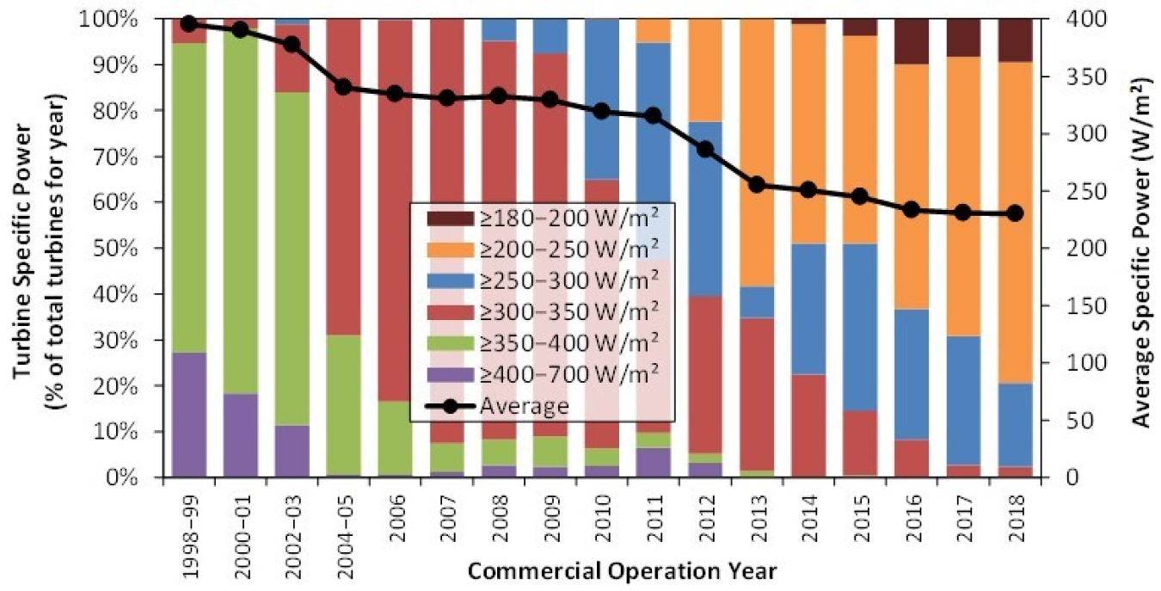
2.i why 250 W/m^2?
Market trends:
[2]
Federico De Mita

Slide 16
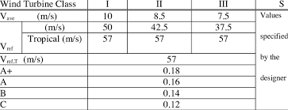
2.i why 250 W/m^2?
Dependance on the site
Site conditions chosen:
Low wind speed conditions
To have a high AEP and a low LCOE: low Rotor Loading and relatively large diameter
[3]
Federico De Mita

Slide 17
[1] J. Serrano-González and R. Lacal-Arántegui, “Technological evolution of onshore wind turbines—a market-based analysis,” Wind Energy, vol. 19, no. 12, pp. 2171–2187, Dec. 2016, doi: 10.1002/WE.1974.
[2] “Top Trends in Wind Technology | Department of Energy.” Accessed: Oct. 06, 2025. [Online]. Available: https://www.energy.gov/eere/wind/articles/top-trends-wind-technology
[3] S. Roach, S. M. Park, E. Gaertner, J. Manwell, and M. Lackner, “Application of the New IEC International Design Standard for Offshore Wind Turbines to a Reference Site in the Massachusetts Offshore Wind Energy Area,” J Phys Conf Ser, vol. 1452, no. 1, Mar. 2020, doi: 10.1088/1742-6596/1452/1/012038.
Federico De Mita

Slide 18
Weekly report: Team Project Development
Week number: 02
Date: 07/10/2025
Supervisor: Dr. Marina Blohm
Group members: Luis Urhahn, Ahmed Sallam, Ceren Cetin, Sohail Mansuri

Slide 19
List of content
Task of this week
Update on soil condition
Distance anaylsis on the sides (Um Aledam vs. Qattinah
Luis Urhahn

Slide 20
1. Tasks of the week
Research on the distances (Luis)
Clarifying the situation regarding the soil (Luis)
Interpolating the measured data to the HH (Ahmed)
Preparing the presentation (Ahmed)
Research on further wind data (measured data) (Sohail + Ceren)
Research on exsitng 5 MW DFIG turbines (Sohail + Ceren)
Luis Urhahn

Slide 21
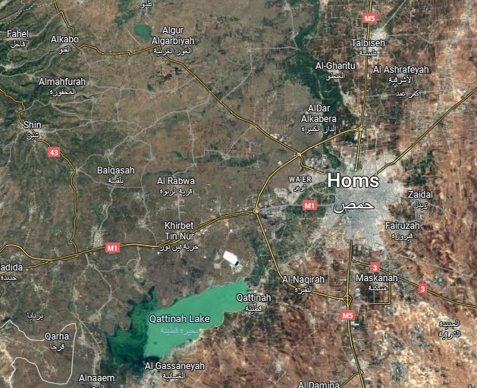
2. Update Soil Conditions – Homs District
Hard to find any soil data in the area…
Most reasonable data by SOIL Grids [1]:
After a discussion with the Foundation-Team:
Both locations possible, but they need improvements!
Site of Qattinah more, due do lots of water in the area (assumption)
Additional costs need to be considered
Depth [m] | Dataset | Clay [%] | Sand [%] | Silt [%]
0-18 | US-NCSS | 58.4 | 17.3 | 24.3
18-45 | US-NCSS | 58.4 | 15.2 | 26.4
45-80 | US-NCSS | 59.8 | 14.4 | 25.8
80-100 | US-NCSS | 59.5 | 13.8 | 26.7
100-130 | US-NCSS | 55.1 | 12.7 | 32.2
Table 1: Soil Condition in Talbiseh (north of Homs), 20 km from sites [1]
Figure 1: Showing the distance from measuring point (yellow) to locations (red) [2]
Luis Urhahn
Notes:
After the meeting with the Foundation-Team we came to the conclusion that both locations in the area of Homs will be suitable for a wind turbine with the size of 5 MW.
But the soil will need improvements, which could be cost intensive in the end.
The shown data in the graph is measuredin Talbiseh, which is not directly at the location (20 km distance).
In general it is really hard to find good and real measured data for the soil in the area…

Slide 22
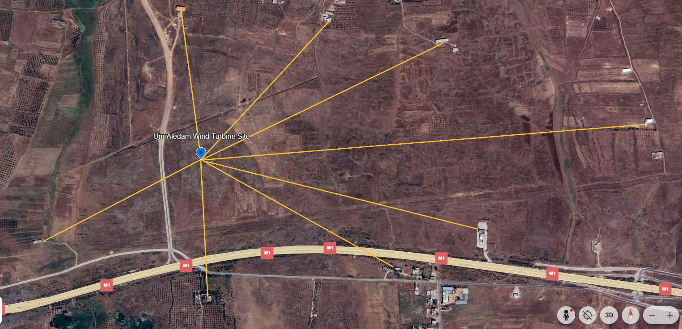
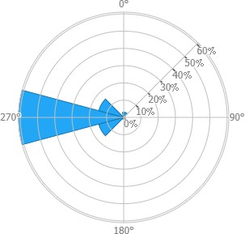
3.1 Distance Analysis– Um Aledam
Final Turbine Location: 34°41'49.6"N
36°30'30.0"E
C
D
E
Building | Distance [m]
Building A | 515 m
Building B | 671 m
Building C | 567 m
Building D | 704 m
Building E | 1 002 m
Building F | 1 671 m
Building G | 1 083 m
Building H | 837 m
F
G
B
H
A
Figure 2: Distances in Um Aledam [3] & [4]
Luis Urhahn
Notes:
Shows the distances to the surrounding buildings.
The critical point is with Building H because it is close to the limit of 800 m in (sometimes) wind direction. Building A-D is not relevant because they are located upwinds. Building C-D could be crucial for shadow flicker! But everything is managable.
Still a good site!
Turbine needs to be regulated when wind from north-west direction (315°)

Slide 23
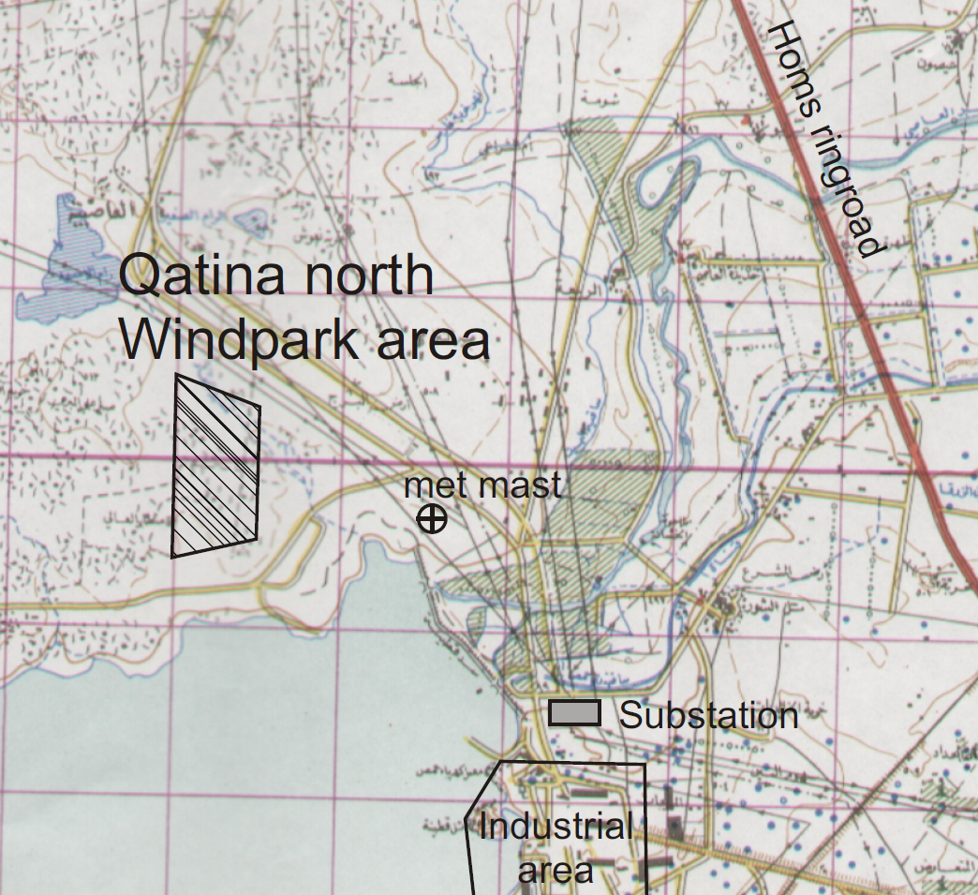
3.2 Distance Analysis– Qattinah
D
E
Final Turbine Location: 34°40'25"N
36°35'44"E
G
Qattinah Turbine Location
H
Figure 3: Windfarm location in Qattinah [5]
Luis Urhahn
Notes:
Shows the location of the possible wind turbine location / wind farm location…
We would also consider this location.
Shows also the longer distance to the substation, but it is definitely manageable!

Slide 24
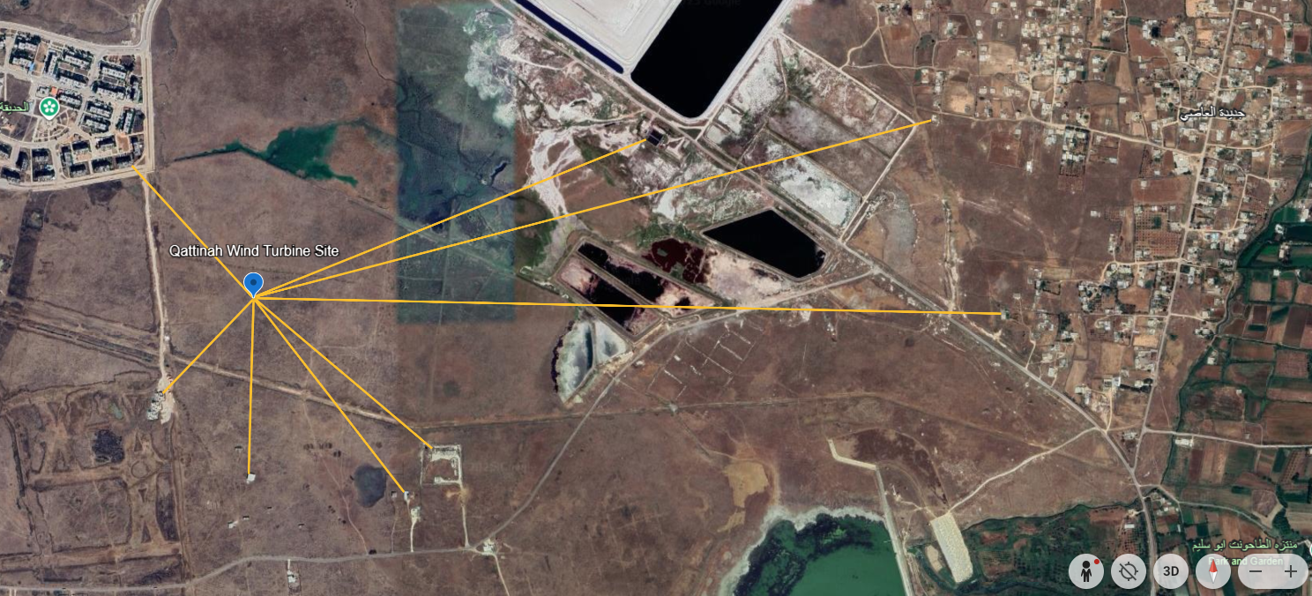
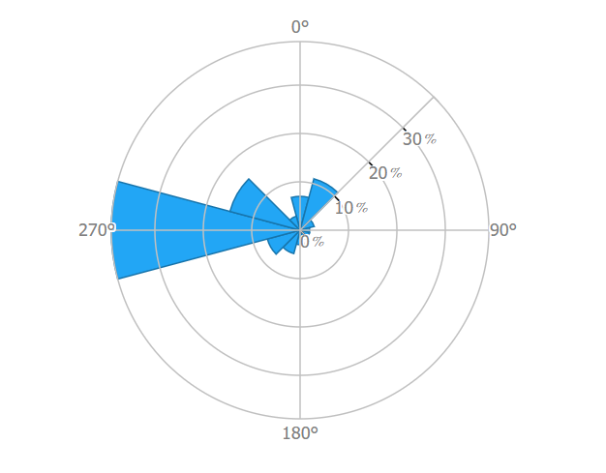
3.2 Distance Analysis– Qattinah
Final Turbine Location: 34°40'25"N
36°35'44"E
Building | Distance [m]
Building A | 440 m
(Building B)* | 1 041 m
Building C | 1 724 m
Building D | 1 845 m
Building E | 577 m
Building F | 603 m
(Building G)* | 428 m
(Building H)* | 321 m
B
C
A
D
H
E
G
F
* Not sure about the building
Figure 4: Distances in Qattinah [3] & [4]
Luis Urhahn
Notes:
Shows the distances to the surrounding buildings.
In general the distance is longer to the surrounding buildings, especially in the main wind dirction, which is cruicual!
Regarding the buildings A, the shaddow flicker will be a problem, but only in the morning ours.
With the buildings F-H, I am not sure if they are in use. I assume its for farmers or so.
In my opinion its the better side now. Only the amount of water resources could be a major problem, but according to the soil analysis it will not be a problem!

Slide 25
3.3 Distance Analysis– Summary
Distances for both locations in main wind direction are out of the critical distance (> 800 m),
A few buildings will limit the turbines performance in some wind directions (North to North-West),
Critical distances in the Qattinah location have a higher value (> 1 500 m)
→ Our suggestion regarding the distance: Qattinah Site
Luis Urhahn

Slide 26
Bibliography – Project Development
[1] Soil Grids, [Online]. Available: https://soilgrids.org/?utm
[2] Google, Google Maps. [Online]. Available: https://maps.google.com
[3] Google, Google Earth. [Online]. Available: https://earth.google.com/web/search/34%c2%b041%2749.6%22N+36%c2%b030%2730.0%22E/@34.67531382,36.5980701,506.39690821a,3513.70885844d,35y,360h,0t,0r/data=CiwiJgokCTkQ2iOXWkFAEQndzvkBWEFAGYw3RwMnREJAIQJ6D_SHPUJAQgIIAUICCABKCAjMjOyYBRAA
[4] Global Wind Atlas, Global Wind Atlas. [Online]. Available: https://globalwindatlas.info/en/
Luis Urhahn

Slide 27



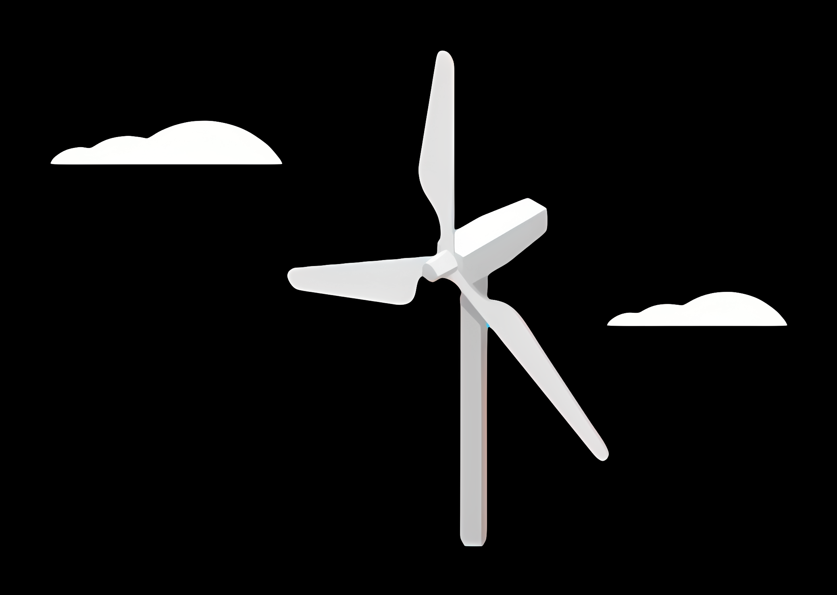
Weekly report: Load & Dynamics
Week number: 02
Date: 07/10/2025
Supervisor: Mr. Manjock
Group members: Md Aman
07/10/2025
Md Aman
Optimus Syria

Slide 28
Agenda
Concept behind DLC* 1.3 & 6.1 according to DNVGL-ST-0437:2016 / IEC 61400-1:2019
ETM & Normal Calculation
TurbSim
Estimated Loads for Optimus Syria based on statistics.
Connected Group & Future Plan
* DLC = Design Load Case
07/10/2025
Md Aman
Load & Dynamics Team/ Optimus Syria

Slide 29
DLC 1.3 & DLC 6.1
Design Load Case 1.3 from the DNVGL-ST-0437 / IEC 61400 wind turbine standard, which typically covers normal operation in extreme turbulent wind conditions.
Design Load Case 6.1 from the DNVGL-ST-0437 / IEC 61400 wind turbine standard, about parked turbine loads (when the turbine is not running).
Specifically: Extreme Wind Model (EWM) when the rotor is parked or idling.
Feature | DLC 1.3 | DLC 6.1
Turbine state | Operating, spinning, active control | Parked or idling, minimal control
Turbulence model | ETM (extreme turbulence) | EWM / ETM variant for park condition
Purpose | Extreme loads during operation | Extreme loads when not operating / safety in storm
Loads driven by | Mean + turbulence + dynamic response | Mostly high wind speeds and static pressure + wind excitation
07/10/2025
29
Load & Dynamics Team/ Optimus Syria

Slide 30
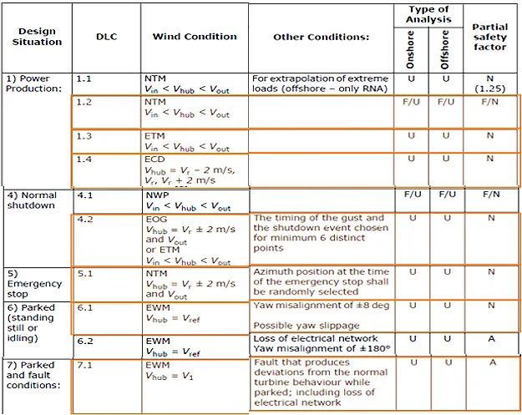
Load cases according to DNV-ST0437 load standard
Simulated load cases planned for this project
Source: DNVGL-ST-0437:2016
07/10/2025
30
Load & Dynamics Team/ Optimus Syria

Slide 31
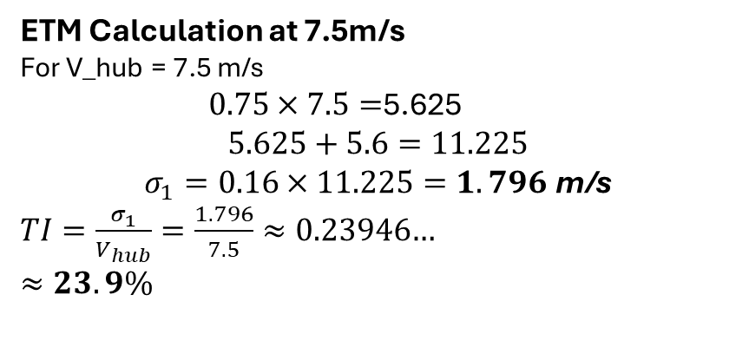
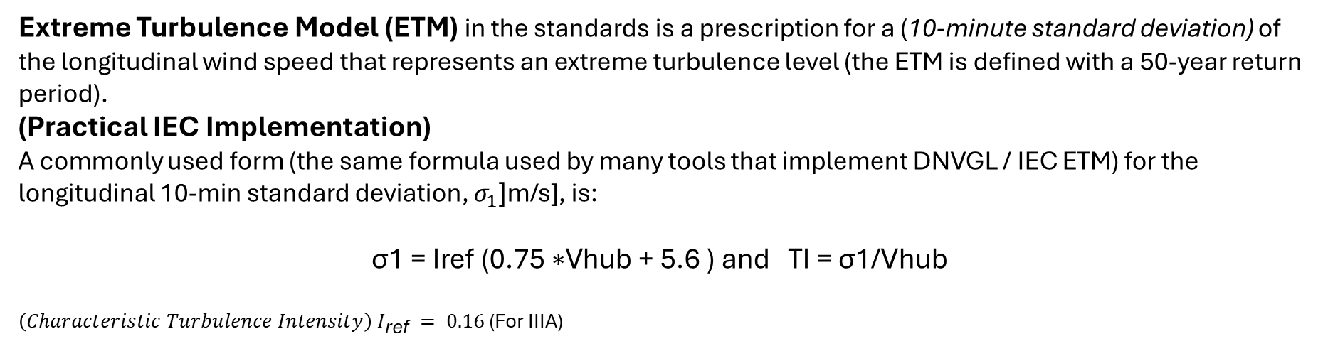
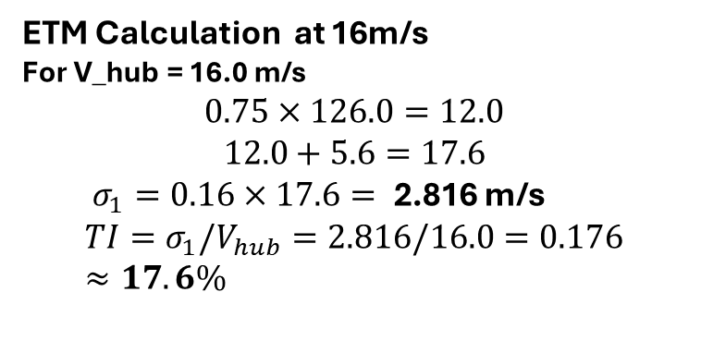
ETM & Normal Operation
Extreme Turbulence Model (ETM) in the standards is a prescription for a (10-minute standard deviation) of the longitudinal wind speed that represents an extreme turbulence level (the ETM is defined with a 50-year return period).
(Practical IEC Implementation) A commonly used form (the same formula used by many tools that implement DNVGL / IEC ETM) for the longitudinal 10-min standard deviation, $σ_{1}$[m/s], is:
$$\text{σ}\text{1} \text{​=} \text{Iref}\text{​ (}\text{0}\text{.}\text{75 }\text{∗}\text{Vhub}\text{​ + }\text{5}\text{.}\text{6 }\text{) }\text{and} \text{TI}\text{ = }\text{σ}\text{1}\text{/}\text{Vhub}\text{​​ }$$
${\left(Characteristic Turbulence Intensity\right) I}_{\text{ref}} = 0.16$ (For IIIA)
ETM Calculation at 16m/s
For V_hub = 16.0 m/s
$$0.75×126.0=12.0$$
$$12.0+5.6=17.6$$
$σ_{1}=0.16×17.6=$2.816 m/s
$$TI=σ_{1}/V_{hub}=2.816/16.0=0.176≈17.6\%$$
ETM Calculation at 7.5m/s
For V_hub = 7.5 m/s
$0.75×7.5=$5.625
$$5.625+5.6=11.225$$
$$σ_{1}=0.16×11.225=1.796 \text{m}\text{/}\text{s}$$
$TI=\frac{σ_{1}}{V_{hub}}=\frac{1.796}{7.5}≈0.23946$…
$$≈23.9\%$$
07/10/2025
31
Load & Dynamics Team/ Optimus Syria

Slide 32
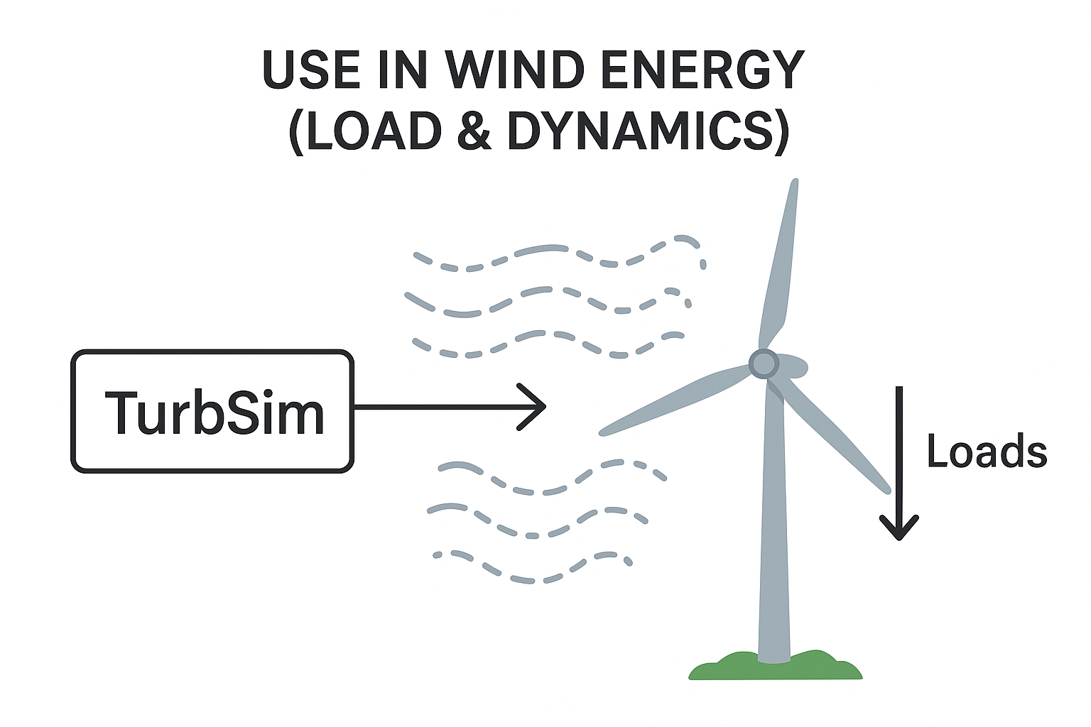
TurbSim
Turb Sim ( Turbulence Simulation )
TurbSim is a stochastic (random) wind field simulator developed by the National Renewable Energy Laboratory (NREL). It generates time-series of three-dimensional wind velocity fields that represent realistic atmospheric turbulence.
Allows to input mean wind speed, turbulence intensity, turbulence length scale, etc. into OpenFAST simulations.
07/10/2025
32
Load & Dynamics Team/ Optimus Syria

Slide 33
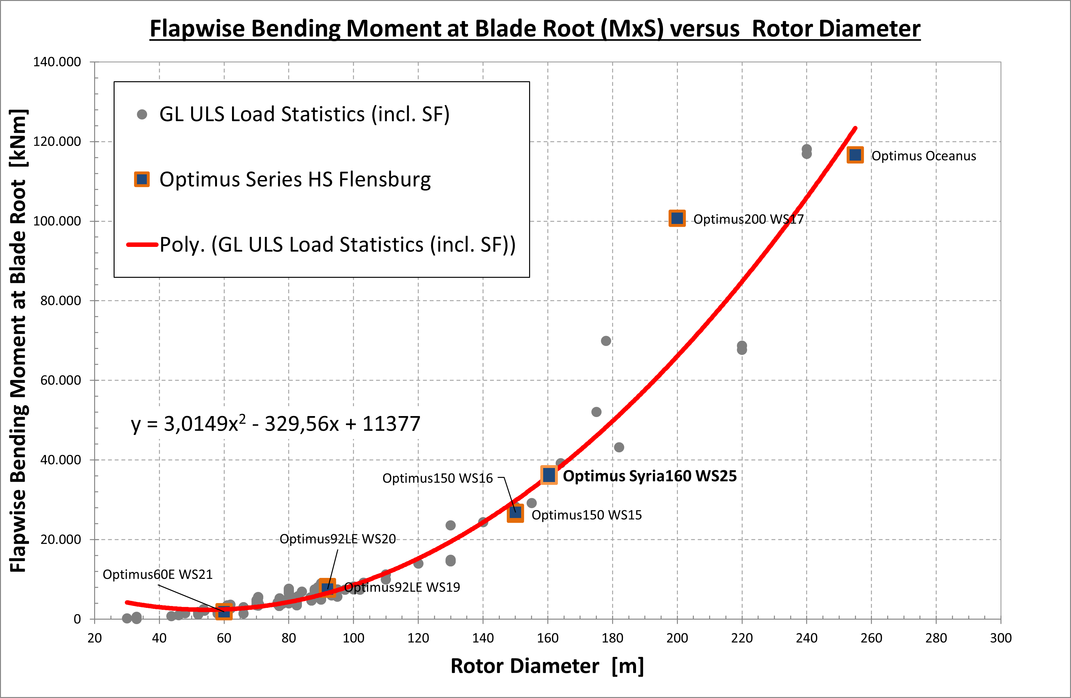
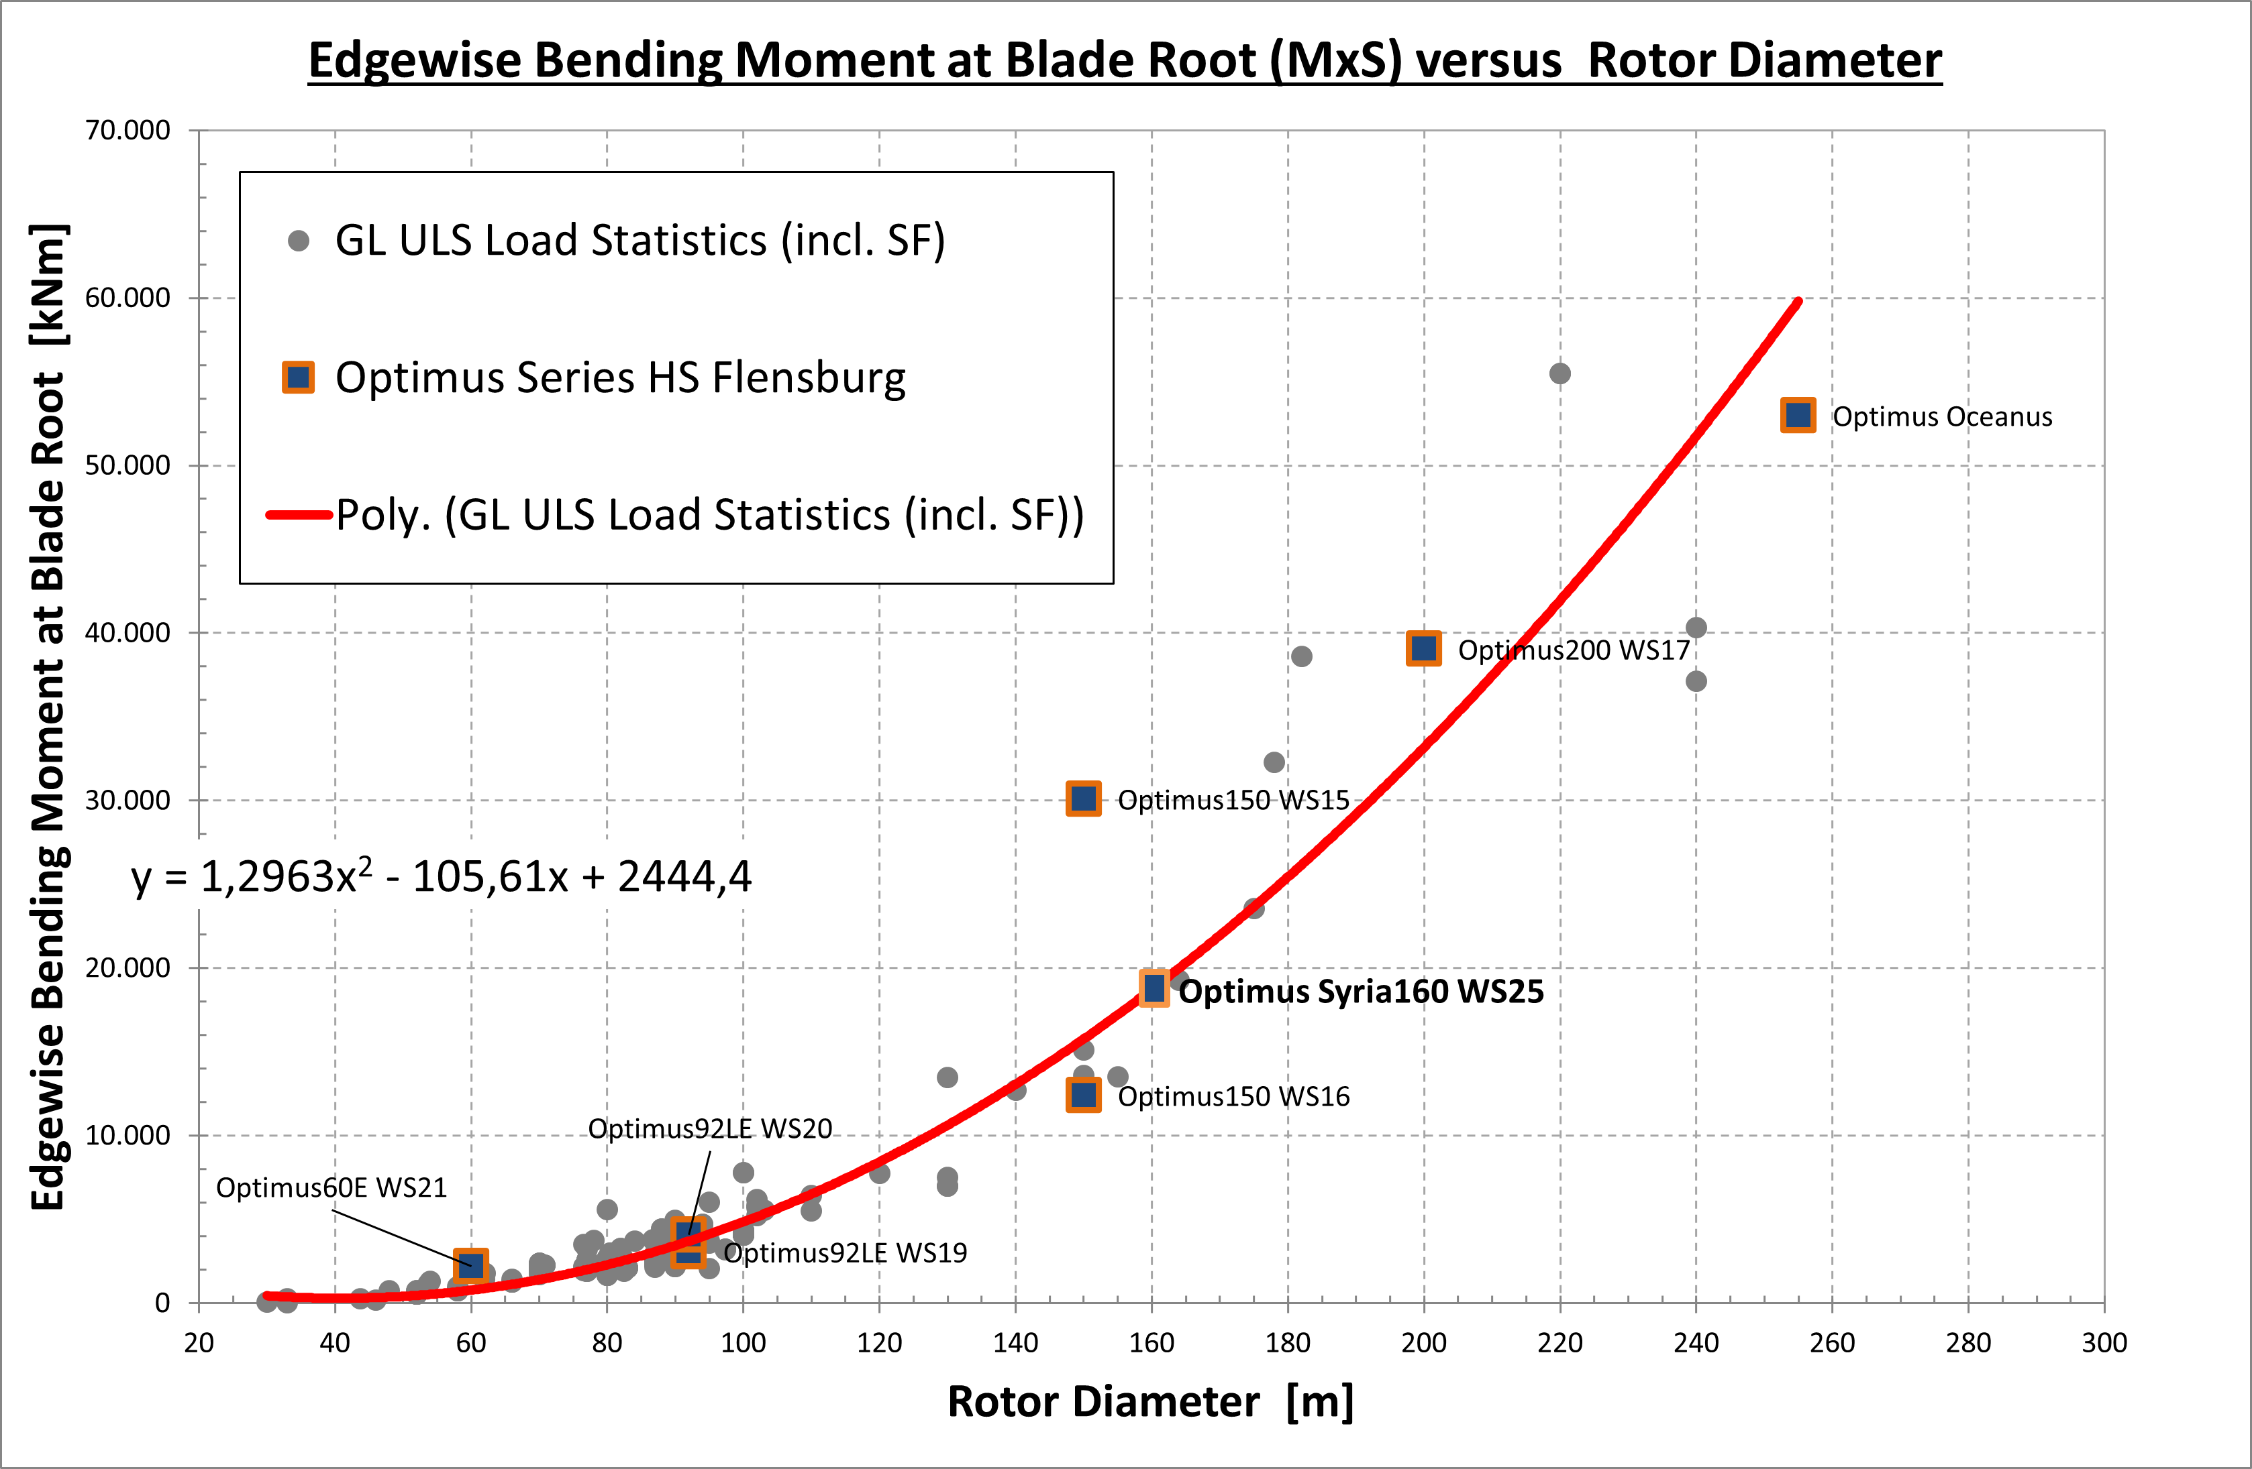
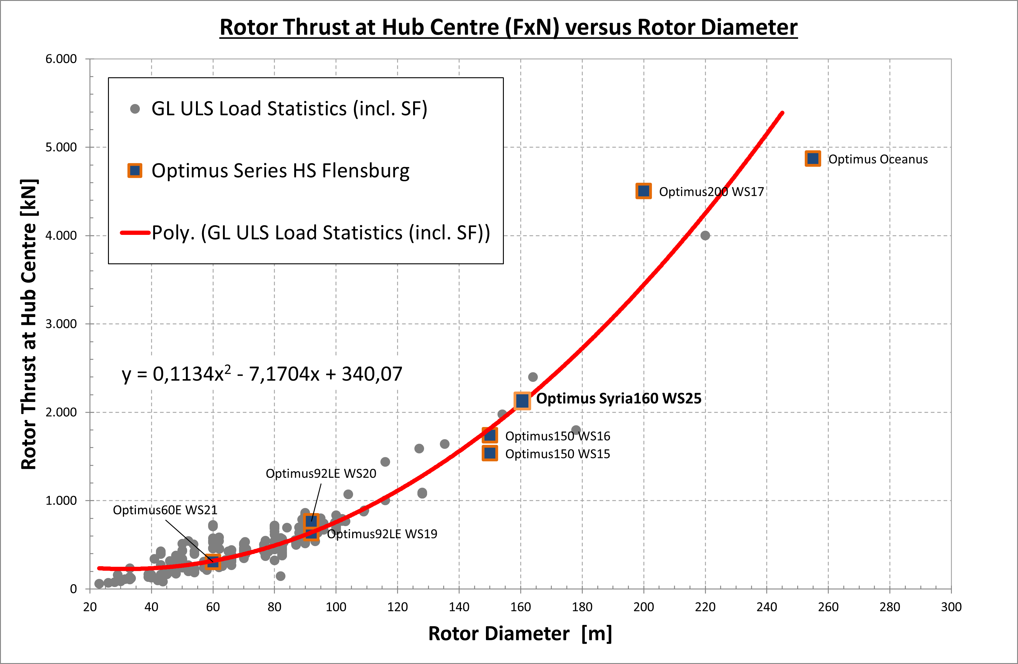
Estimated Extreme Loads for Optimus Syria
07/10/2025
33
Load & Dynamics Team/ Optimus Syria

Slide 34
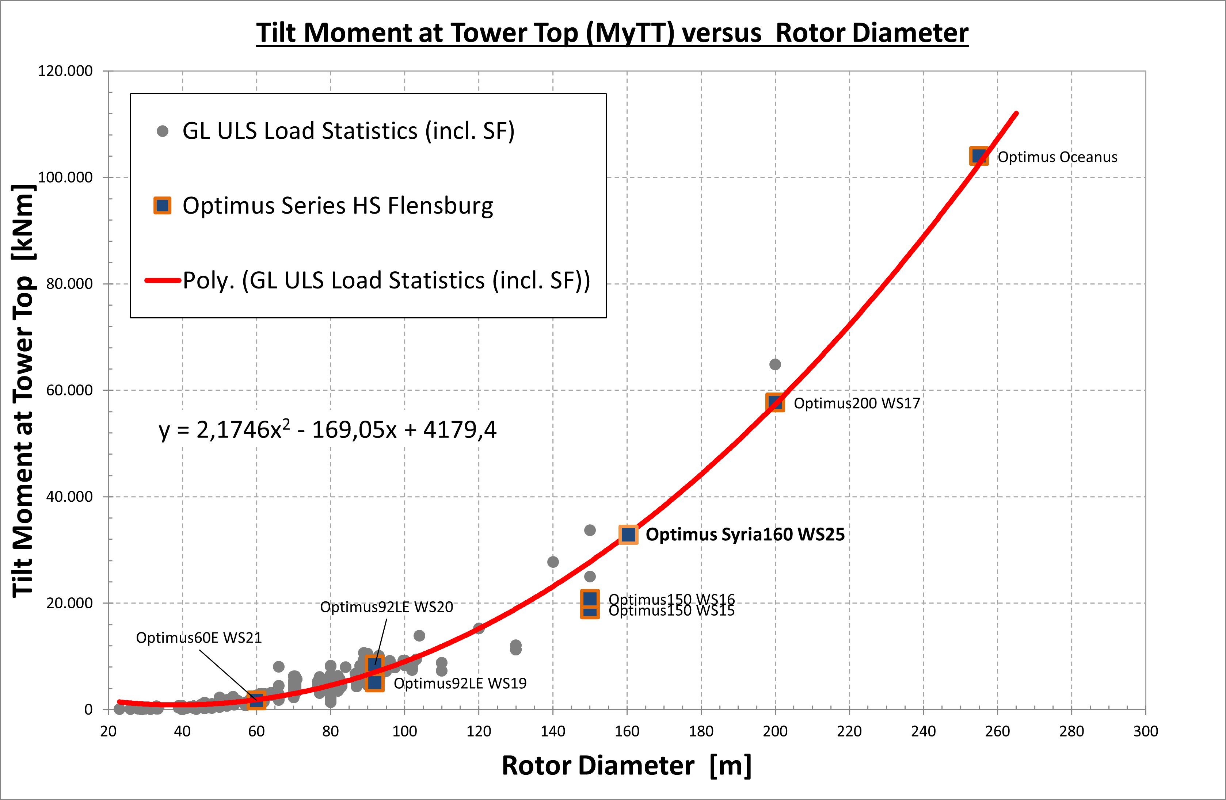
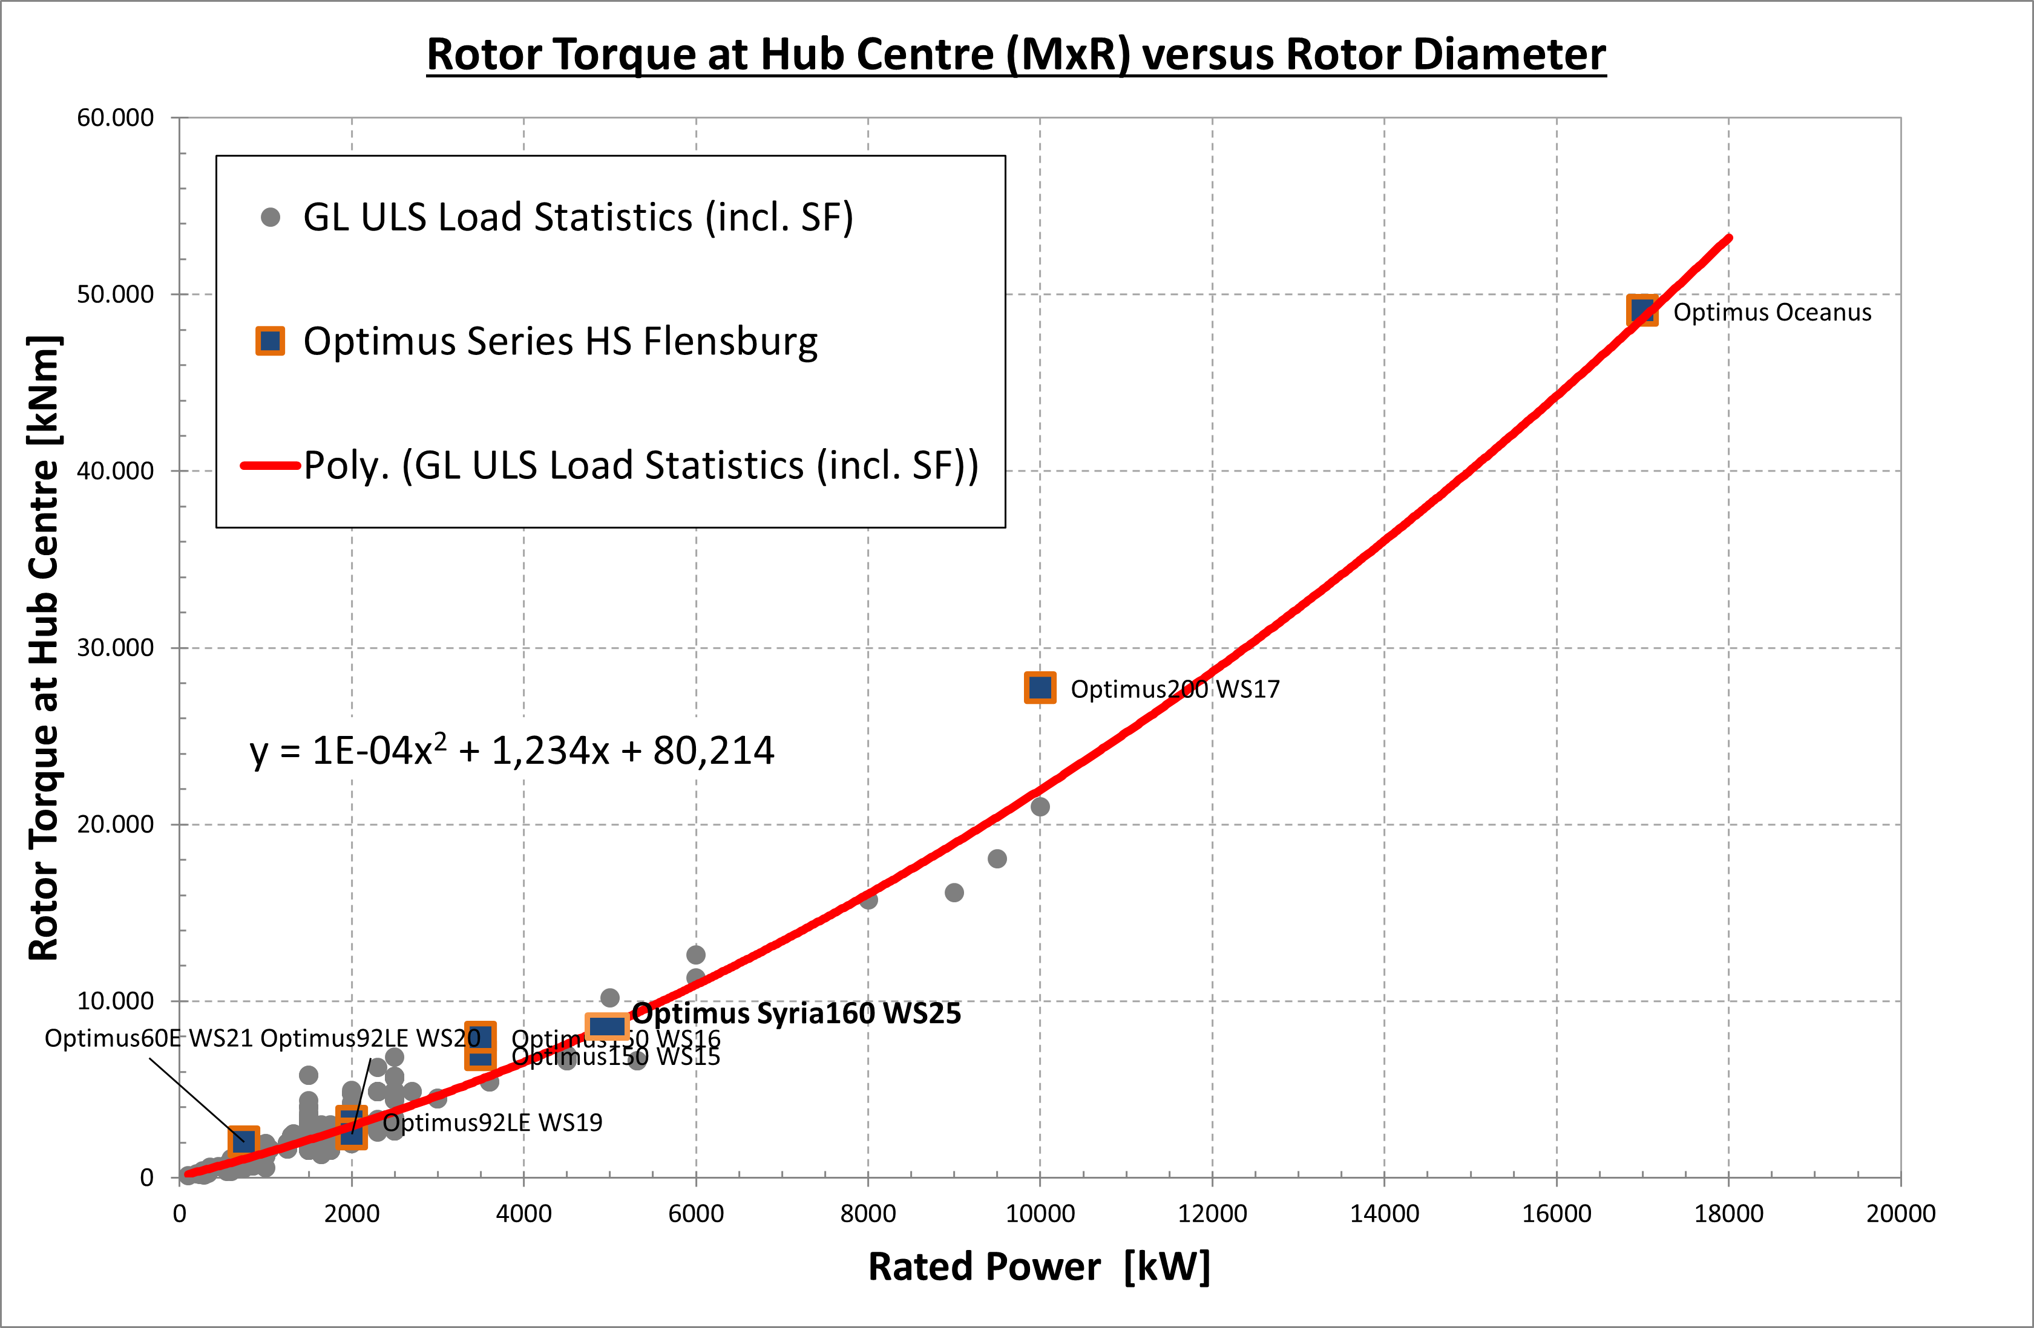
Estimated Extreme Loads for Optimus Syria
07/10/2025
34
Load & Dynamics Team/ Optimus Syria

Slide 35
Estimated Extreme Loads for Optimus Syria
All values represent extreme loads (ULS) and already include the corresponding partial safety factors (γF).
 | Blade Edge moment | Blade Flap moment | Rotor thrust | Yaw Bearing Tilt moment | Rotor torque | Tower-bottom | Diameter | Tower height | Rated Power
 | kNm | kNm | kNm | kNm | kNm | kNm | m | m | KW
Optimus150 WS15 | 30,103 | 26,341 | 1,535 | 18,793 | 6,941 | 256,308 | 150 |  | 3,500
Optimus150 WS16 | 12,413 | 26,770 | 1,737 | 20,817 | 7,925 | 284,580 | 150 | 140 | 3,500
Optimus200 WS17 | 39,052 | 100,649 | 4,503 | 57,713 | 27,729 | 681,780 | 200 | 143 | 10,000
Optimus Oceanus | 52,998 | 116,570 | 4,872 | 103,990 | 49,073 | 1,189,800 | 255 | 150 | 17,000
Optimus92LE WS19 | 3,074 | 8,184 | 630 | 5,082 | 3,194 | 64,590 | 92 | 80 | 2,000
Optimus92LE WS20 | 4,070 | 7,495 | 764 | 8,432 | 2,471 | 86,020 | 92 | 80 | 2,000
Optimus60E WS21 | 2,204 | 1,872 | 304 | 1,708 | 2,005 | 28,567 | 60 | 70 | 750
Optimus Shakti | 18,358 | 42,563 | 2,376 | 29,331 | 12,496 | 376,242 | 178 | 140 | 5,000
Optimus Syria | 18,732 | 35,830 | 2,095 | 32,786 | 8,500 | 284,186 | 160 | 120 | 5,000
07/10/2025
35
Load & Dynamics Team/ Optimus Syria

Slide 36
Connected Group & Future Plan
Feedback Control
Talked with them for Wind field
Simulation result with MatLab Simulink
Rotor Blade Design & Structure
Provided them the needed parameter for load simulations
In the next week I’ll
contact with Tower Structure team
Configure OpenFast
Create Turbulent wind Field with TurbSim
Start With Other DLC
07/10/2025
36
Load & Dynamics Team/ Optimus Syria

Slide 37
References
Load Reports of the OPTIMUS projects
Loads and site conditions for wind turbines, DNVGL-ST-437,Edition November 2016
NREL 5 MW
Load Simulation Seminar 2025 by Mr. Manjock
07/10/2025
37
Load & Dynamics Team/ Optimus Syria

Slide 38
Weekly report: Feedback Controller
Week number: 02
Date: 07/10/2025
Supervisor: Prof. Dr.-Ing. David Schlipf
Group members: Mirza Dincer, Saurabh Pankaj Jha
Presenter: Mirza Dincer

Slide 39
List of Contents
Tasks of the Week
Why IEA 3.4 MW?
ROSCO Workflow
Simulation Settings
Results
Conclusion
Mirza Dincer - 780261

Slide 40
Tasks of the Week
Migrate files of IEA 3.4-MW model to OpenFAST v3.0 and ROSCO v2.6.0 due to them being compatible for Lidar applications
Run Simulation of the IEA 3.4-MW with feedback-only control without Lidar-Assisted controller.
Mirza Dincer - 780261

Slide 41
Why IEA 3.4 MW ?
Rated power capacity: 3.4 MW, designed for utility-scale wind energy generation.
Supports advanced control strategies such as individual pitch control and yaw optimization.
ROSCO implementation allows research-driven improvements and customization for specific turbine control requirements.
Facilitates simulation and testing through OpenFAST.
Clean and well documented example to start.
[1]
Mirza Dincer - 780261

Slide 42
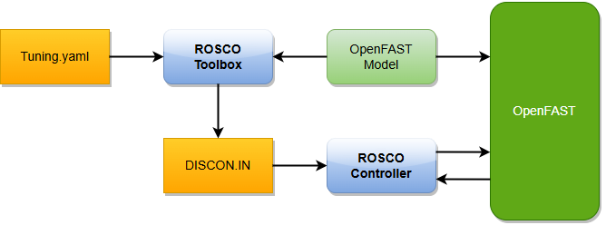
ROSCO Workflow
DLL (Dynamic Link Library)
Linked via ServoDyn.
Manages I/O between OpenFAST and control logic.
IN (Controller Input)
Parameter file for the DLL.
Holds feature flags, modes, gains.
Standard ROSCO workflow showing controller structure and interaction between OpenFAST and ROSCO.
[2]
Mirza Dincer - 780261

Slide 43
Simulation settings
30 seconds of simulation.
Wind speed with 12 m/s, ‘Mexican Hat’ shaped gust up to 15 m/s.
Only enabled Rotor DOF and First fore-aft tower bending-mode DOF.
Set initial conditions of rotor speed, pitch angle, tower top positions. So that turbine starts in steady state.
Running only feedback controller, no Lidar-assisted controller.
Mirza Dincer - 780261

Slide 44
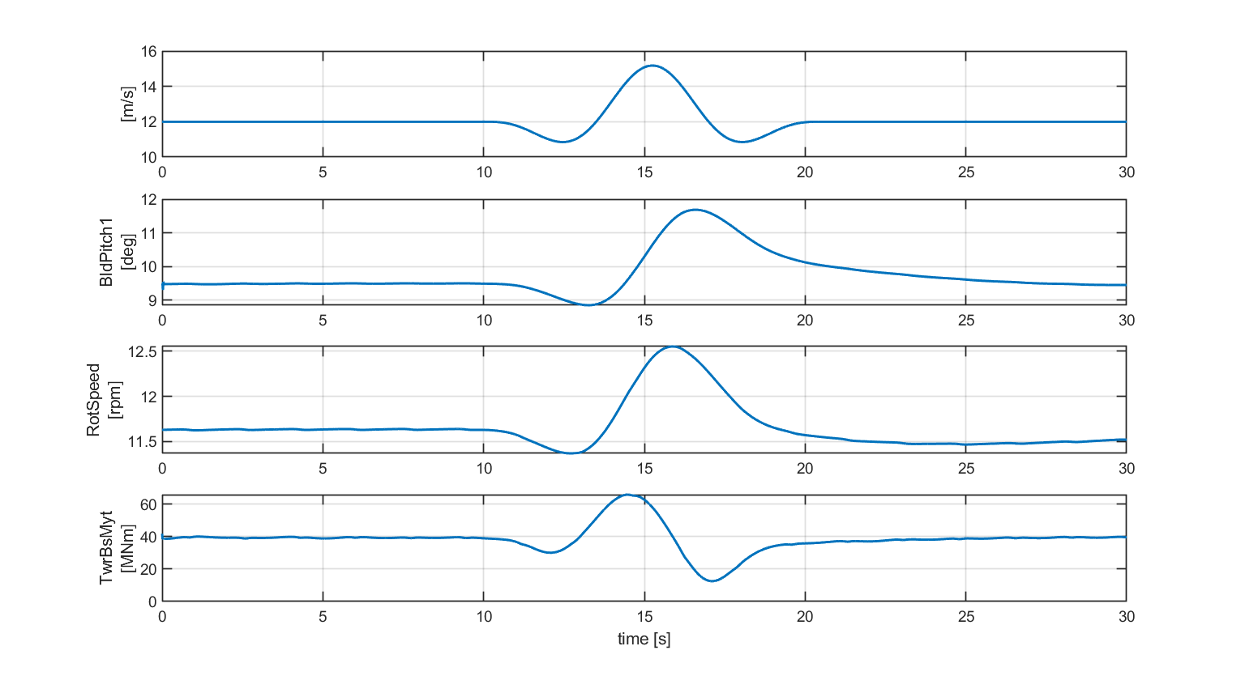
Results
Simulation results for IEA 3.4 MW with feedback control.
Mirza Dincer - 780261

Slide 45
Conclusion
Learned how to couple ROSCO and OpenFAST.
Learned how to update OpenFAST files and ROSCO.
Should discuss with load and dynamics team for OpenFAST version for the project.
Will be updating GitHub simulation files.
Mirza Dincer - 780261

Slide 46
Bibliography – Feedback Controller
[1] P. Bortolotti et al., “IEA Wind TCP Task 37: Systems Engineering in Wind Energy - WP2.1 Reference Wind Turbines,” OSTI OAI (U.S. Department of Energy Office of Scientific and Technical Information), May 2019, doi: https://doi.org/10.2172/1529216.
[2] N. J. Abbas, D. S. Zalkind, L. Pao, and A. Wright, “A reference open-source controller for fixed and floating offshore wind turbines,” Wind Energy Science, vol. 7, no. 1, pp. 53–73, Jan. 2022, doi: https://doi.org/10.5194/wes-7-53-2022.

Slide 47


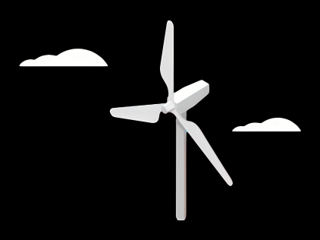
Report: Lidar Assisted Controller
Date: 05/10/2025
Supervisor: Prof. David Schlipf
Group members: Annika Gathje, Hesham Mahmoud, Midhun Kanichattu Venu

Slide 48
New functions in the simulator OpenFAST
Envolving turbulence
→ previous assumption: Taylor‘s frozen turbulence (wind remains constant during transport)
→ new: integration of evoTurb (stochastic wind field)
→ wind development reduces correlation between measured and actual wind speed
→ realistic prediction of Lidar data
Blade blockage effect = Lidar beams can be blocked by rotor blades
→ algorithm detects blockage through geometric modelling of the leaves
→ important for signal availability and data processing
Adjustable data availability = Lidar data is dependent on CNR (carrier to noise ratio)
→ modelling via spectral analysis: realistic simulation of data gaps

Slide 49
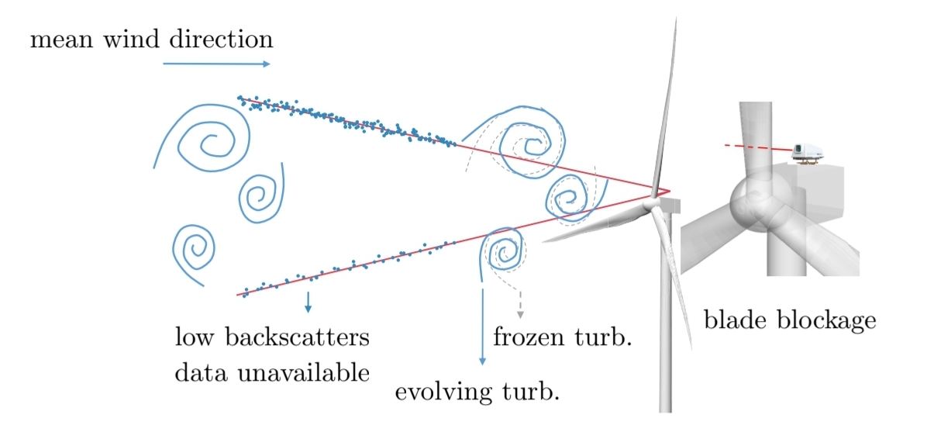
Frozen turbulence
8

Slide 50
New functions in the simulator OpenFAST
Envolving turbulence = integration of evoTurb (stochastic wind field)
→ wind development reduces correlation between measured and actual wind speed
→ realistic prediction of Lidar data
Blade blockage effect = Lidar beams can be blocked by rotor blades
→ algorithm detects blockage through geometric modelling of the leaves
→ important for signal availability and data processing
Adjustable data availability = Lidar data is dependent on CNR (carrier to noise ratio)
→ modelling via spectral analysis: realistic simulation of data gaps

Slide 51
Method and Implementation
EvoTurb integration
→ simulate wind fields for rotor and Lidar separately
Blade blockage detection
→ simplified geometry and Ray Triangle interaction algorithm
CNR modelling
→ empirical spectrum and white noise comparison

Slide 52
Setup & Tuning (OpenFAST v3.0 • ROSCO v2.6 • IEA 3.4 MW)
 | Feedback(baseline) | FF(feedforward)
DLL_FileName | ROSCO.DLL | WRAPPER.dll
DLL_InFile | IEA-3.4-130 RWT_DISCON.IN | WRAPPER.IN
ProcName | DISCON | DISCON
FFP tuning: LPF=0.5 rad/s, buffer=3 s, curve ↓ • KPIs: t>12 s, GenSpeed std & Pitch-rate std).

Slide 53
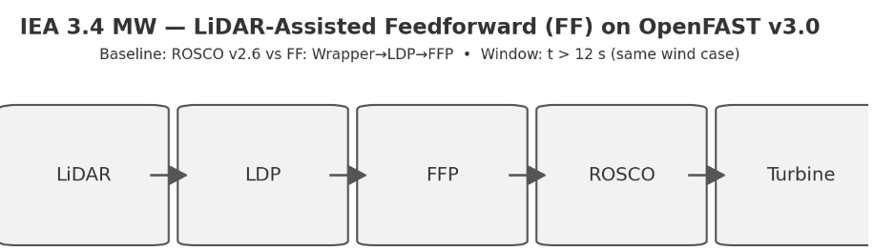
IEA 3.4 MW — LiDAR-Assisted Feedforward (FF) on OpenFAST v3.0

Slide 54
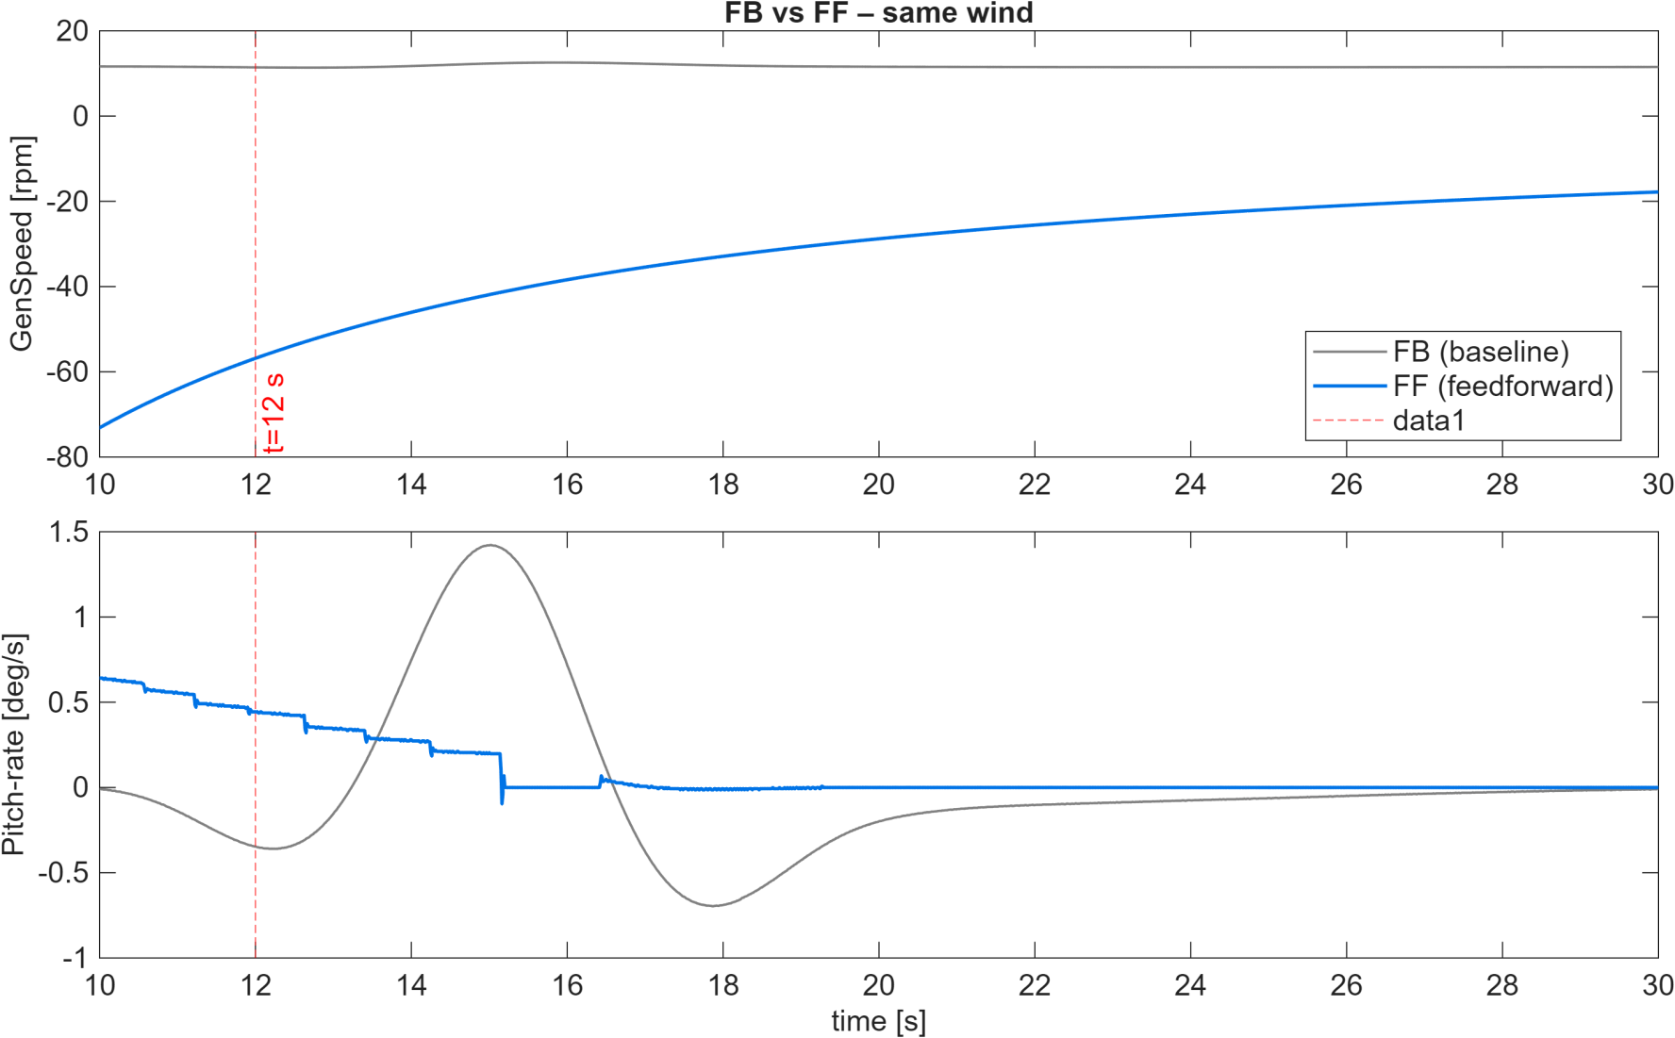
Results: FB vs FF (Same Wind, t = 10–30 s)
FB vs FF same wind (t=10–30 s), KPIs on t>12 s: GenSpeed std & Pitch-rate std.

Slide 55
Conclusion and Outlook
Realistic Lidar simulation is crucial for controller development
The three new features significantly improve model fidelity
→ Indispensable for interpreting data correctly
Adaptation to local atmospheric conditions necessary
controller must be able to deal with data gaps e.g. buffer storage, interpolation, adaptive control strategies
- position and orientation of the control system must be strategically chosen to minimise blockage

Slide 56
Reference
[1] Matthew L Aitken, Michael E Rhodes, and Julie K Lundquist.
Performance of a wind-profiling lidar in the region of wind turbine rotor disks.
Journal of Atmospheric and Oceanic Technology, 29(3):347–355, 2012.
[2]Matthieu Boquet, Philippe Royer, Jean-Pierre Cariou, Mehdi Machta, and Matthieu Valla.
Simulation of doppler lidar measurement range and data availability.
Journal of Atmospheric and Oceanic Technology, 33(5):977–987, 2016
[3]David Schlipf. Lidar-Assisted Control Concepts for Wind Turbines.
Dissertation, University of Stuttgart, 2015.
[4] David Schlipf, Feng Guo, and Steffen Raach. Lidar-based estimation of turbulence
intensity for controller scheduling. Journal of Physics: Conference Series, 1618:032053, sep 2020.
[5] David Schlipf, Steffen Raach, and Florian Haizmann. Control system for controlling a turbine,
method for controlling a turbine, and wind turbine, Patent EP3717770B1, 2018

Slide 57
Rotor Blade and Aerodynamics
Week: 3
Date: 07/10/2025
Supervisor: Prof. Dr. rer.nat. Alois Schaffarczyk
Harsh Panchal, Jay Pandya, Kandarp Pathak, Daniyal Sikander

Slide 58
List of contents
Flow Chart
Selected Airfoils
Airfoil Analysis Graphs
Harsh Panchal Matriculation Number 770278

Slide 59
1. Flow Chart
Reynolds number
Airfoil selection according to thickness
Airfoil analysis (Cl/Cd vs AOA),(Cl vs AOA),(Cd vs AOA)
360 degree Polar Generation
Blade Design
Chord , Twist, Bezier Curve( For smooth blade design)
Harsh Panchal Matriculation Number 770278

Slide 60
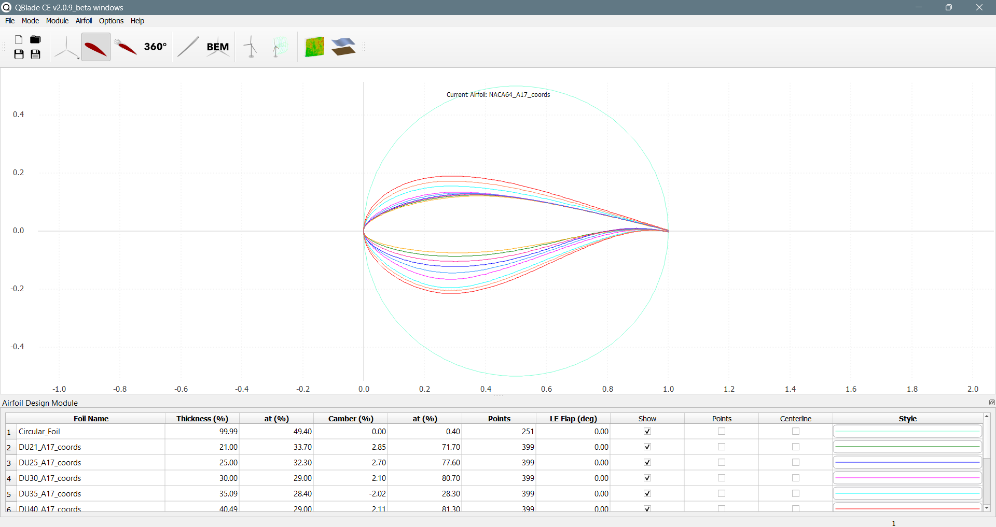
2. Selected Airfoils
Circular Foil 6. DU40
DU21 7. NACA64
DU25
DU30
DU35
Harsh Panchal Matriculation Number 770278

Slide 61
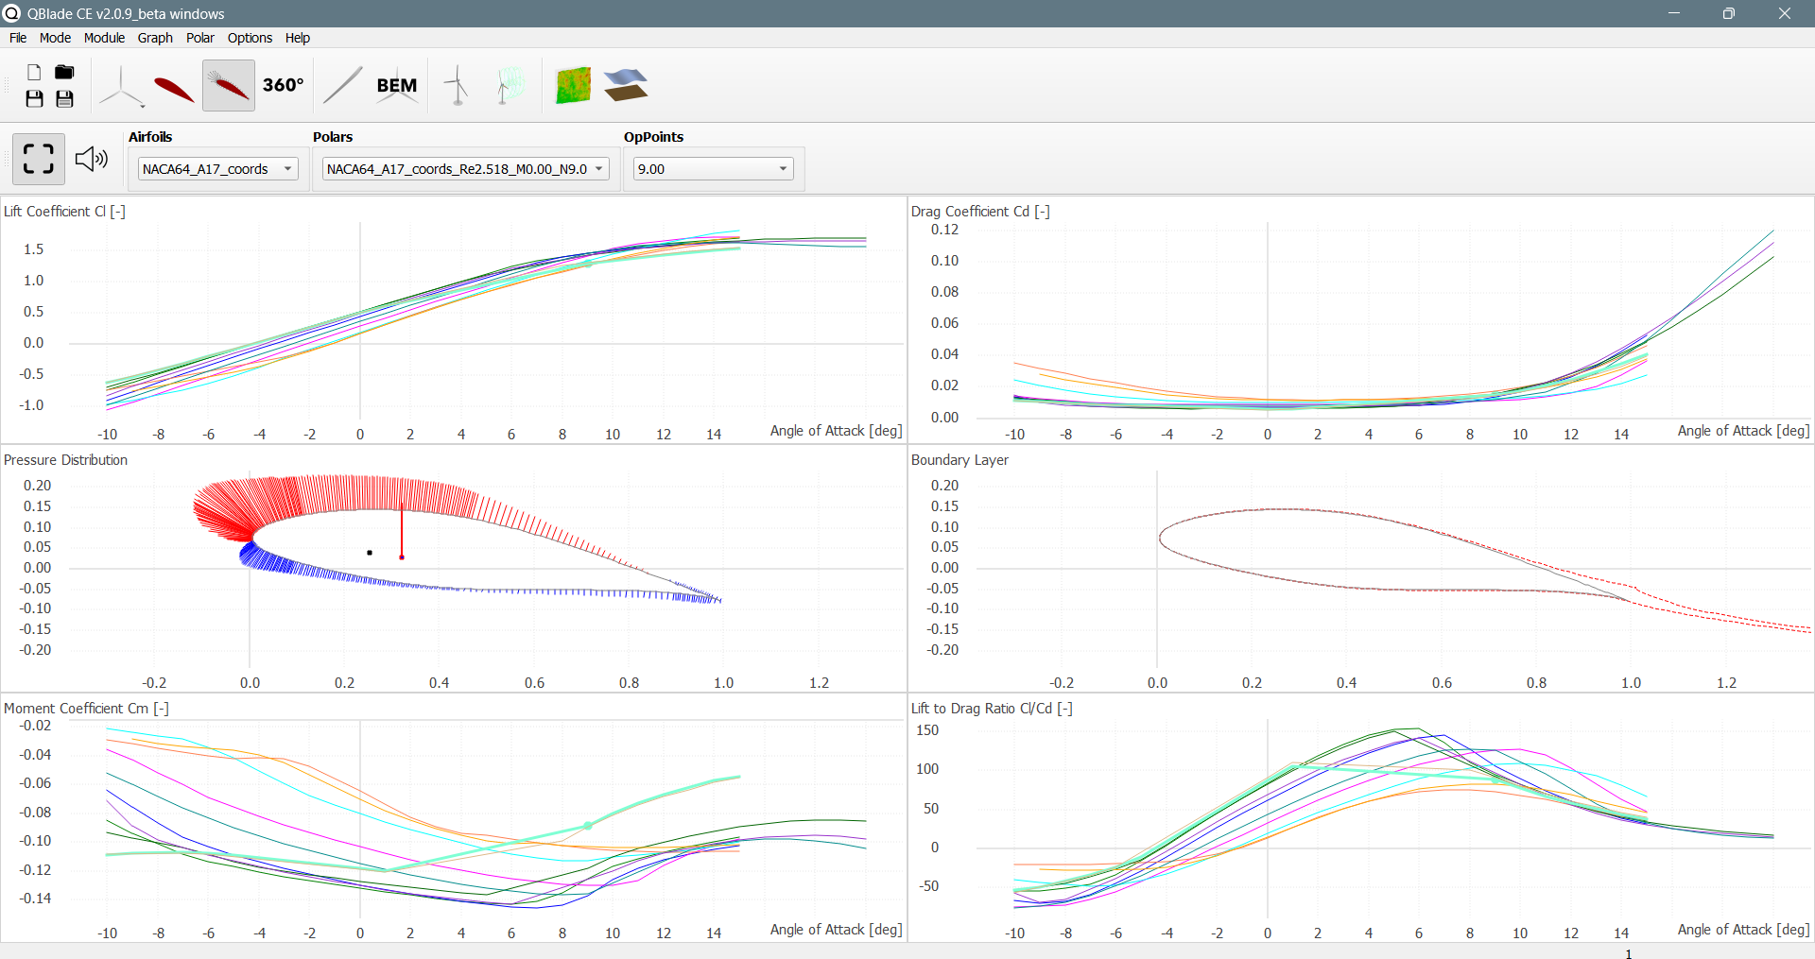
Graphs
Harsh Panchal Matriculation Number 770278

Slide 62
Bibliography
http://airfoiltools.com/search/index?m%5Bgrp%5D=naca4d&m%5Bsort%5D=1
https://qblade.org/
Harsh Panchal Matriculations Number 770278

Slide 63
Team 5 – Rotor Blade Structures
Week number: 2
Date: 07.10.2025
Supervisor: Dr. Laurence Alhrshy
Bhima B Masare, Anudeep Allanki, Dongsuk Kim, Mithun Shetty

Slide 64
List of contents
Sample Blade Geometry by Aero Team
Positioning the Airfoils (will be provided by Aero Team)
Calculating Blade Structural properties
Bibliography
Anudeep Allanki

Slide 65
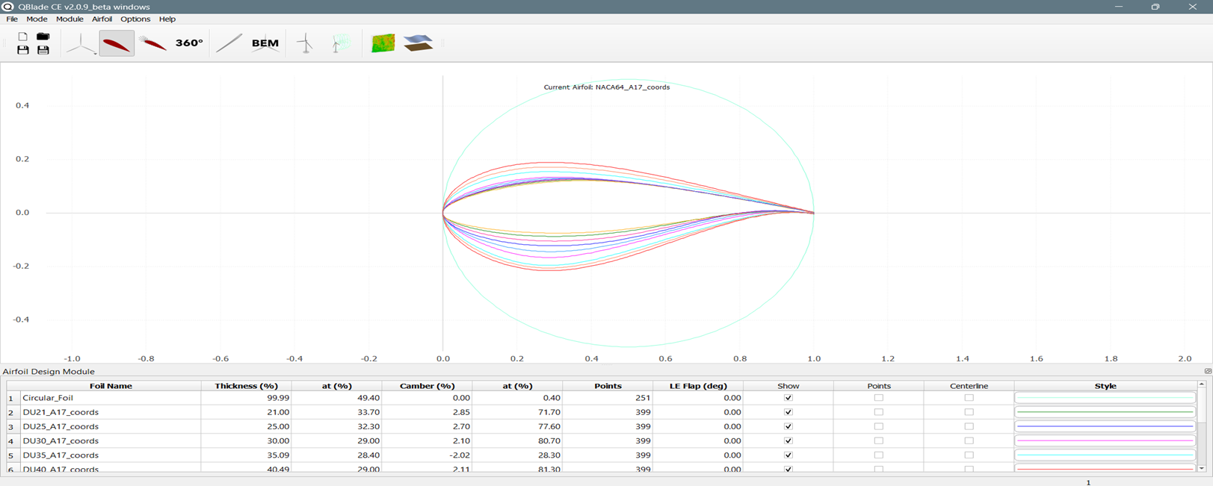
Sample Blade Geometry by Aero Team
Circular Foil
DU21
DU25
DU30
DU35
DU40
NACA64
Anudeep Allanki

Slide 66
Sample Blade Geometry by Aero Team
Rearrange the Airfoils positions on Blade span (correction)
From Root to tip of Blade the order follows –
Circular Foil1
Circular Foil 2
DU40
DU35
DU30
DU25
DU21
NACA64
Note –
NACA 0060 can be added followed by circular foils as per observations from WEC Optimus Shakti 2024
Anudeep Allanki

Slide 67
Sample Blade Geometry by Aero Team
Rearrange the Airfoils positions on Blade span (correction)
From Root to tip of Blade the order follows –
Circular Foil1
Circular Foil 2
DU40
DU35
DU30
DU25
DU21
NACA64
Note –
NACA 0060 can be added followed by circular foils as per observations from WEC Optimus Shakti 2024
Anudeep Allanki

Slide 68
Data needed to proceed further
 | Data required from Aero Team
 | Data calculated by Structure Team
Anudeep Allanki

Slide 69
Bibliography
Definition of a 5 MW/61.5m Wind Turbine Blade Reference Model by Brian R. Resor, Sandia National Laboratories, California, USA
Definition of a 5 MW Reference Wind Turbine for Offshore System Development, J. Jonkman, S. Butterfield, W. Musial, and G. Scott, National Renewable Energy Laboratory, USA
Q Blade Design from Blade Aerodynamics Team

Slide 70
Weekly report: Electrical Drivetrain
Week number: 3
Date: 07/10/2025
Supervisor: Prof. Dr.-Ing. Saiju
Group members: Aiswarya Vijayan, Vishranti Shivajirao Patil , Girish Mahadeo Padalkar, Cristina Milene Vergara Hernandez
Presented By : Girish Padalkar

Slide 71
List of contents
DFIG Working Principle
Converter Rating
Local Partner & Market Strategy
Physical and Cost Parameters
Conclusion & Next Steps
Presented By : Girish Padalkar
Electrical Drive Train/ Optimus Syria

Slide 72
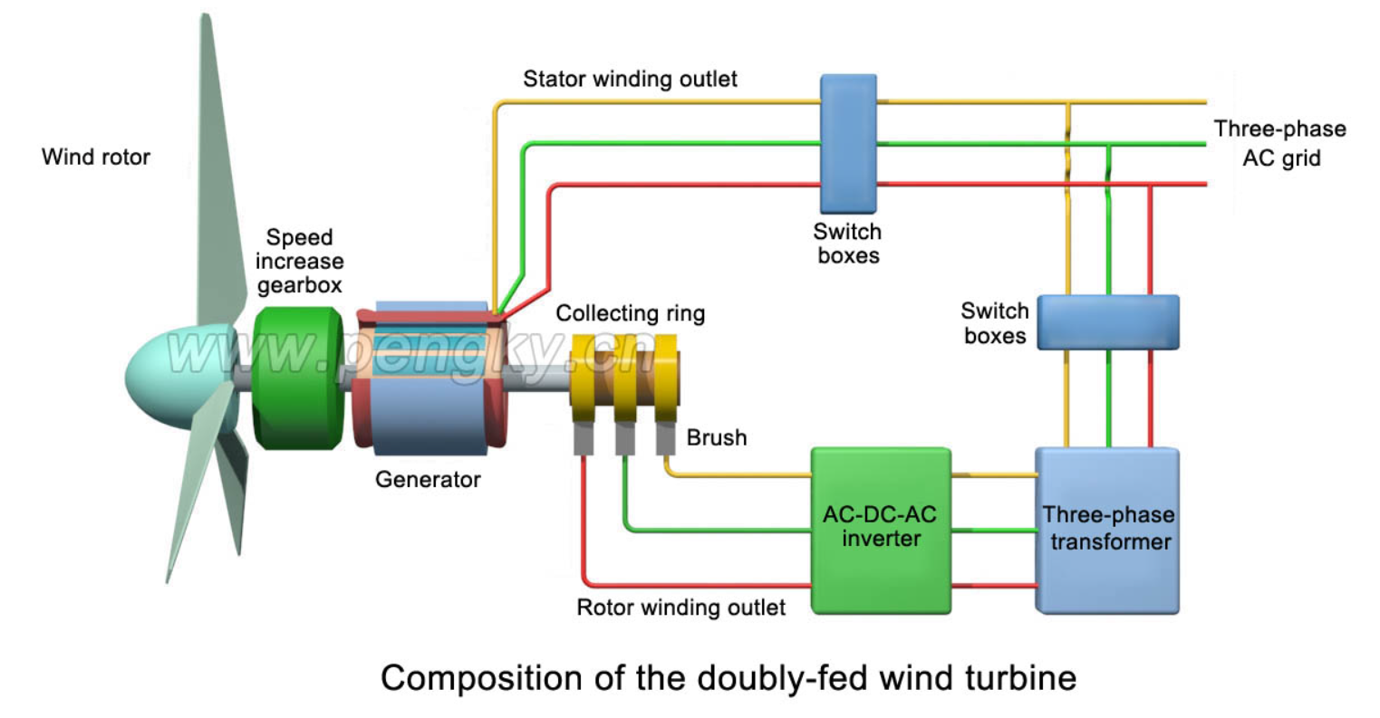
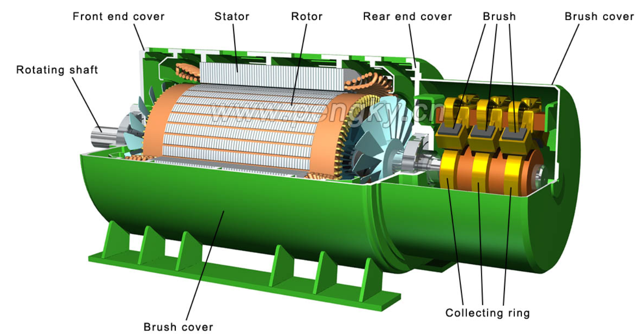
1. DFIG Working Principle
Rotor connected via slip rings to partial converter
Stator directly connected to grid
Enables variable-speed operation
Power flow
Active Power : Supplied via stator and rotor.
Reactive Power : Controlled by rotor-side converter.
Bidirectional flow : Converter enables flexible grid support.
[2]
[1]
Presented By : Girish Padalkar

Slide 73
2. Converter Rating
Partial converter : ~25 -30% of generator capacity.
For 5MW DFIG : ~1.2 MW to 1.5 MW .
Lower cost and losses vs. full-scale converters.
Physical Parameters (5MW DFIG )
Parameter | Value/Range
Outer Diameter (Stator) | 2.0 – 2.5 m
Axial length | 2.0 – 2.5 m
Air Gap length | 1.0- 3.0 m
Rotational speed | 1,500 – 2,000 rpm
Generator mass | 20 – 30 tons
Presented By : Girish Padalkar

Slide 74
3. Local Partner & Market Strategy
Manufacturer / Supplier | Relevant Model / Platform | Generator Type (DFIG) | Approx. Generator Weight (Component Only) | Estimated | Manufacturer / Supplier
WDRVM (Syria) | 3.X MW to 10.X MW Platforms | Geared DFIG / PMSG | N/A (Local Assembly) | Negotiable (Local Content Priority) | Initial priority for local content and support specific to Syrian grid.
Siemens Gamesa | SG 5.0-145 (2.0) Onshore | Geared DFIG | 20 to 30 Tons | $1.2 M to $1.6 M | Confirmed commercial 5.0 MW product, acts as primary European technical benchmark.
SANY | SI-16050 SE16050 (5.0 MW) | Geared DFIG | 20 to 30 Tons | $1.0 M to $1.3 M | High-volume Asian supplier; provides aggressive cost and delivery benchmark.
GE Vernova | 4.8 MW to 6.1 MW Platforms | DFIG | 20 to 30 Tons | $1.2 M to $1.6 M | Active development in this capacity range, offering competitive U.S./Global technology.
ABB / WEG | Components Only | Standalone DFIG / PMSG | 20 to 30 Tons | N/A (Component Cost) | Critical component suppliers for local WDRVM assembly or repair/maintenance.
Presented By : Girish Padalkar

Slide 75
4. Physical and Cost Parameter
Generator Specifications (Estimated for a 5 MW Geared DFIG)
Table below: Specific dimensions and air gap are proprietary data. The figures below are typical industry estimates for a high-speed, geared DFIG rated at 5 MW (50 Hz grid).
Parameter | Estimated Value / Range | Unit | Implication for Project
Rated Power | 5,000 | kW | Project Requirement
Rated Voltage | 690 | V | Standard low-voltage output for large turbines (steps up via transformer).
Maximum Speed | 1,500 to 2,000 | rpm | Requires high-ratio gearbox (typically 1:80 to 1:100).
Air Gap Length | 1.0 to 3.0 | mm | Critical for efficiency and magnetic coupling. Small air gap minimizes reactive power needs.
Outer Diameter (Stator) | 2.0 to 2.5 | m | Determines nacelle size and logistical requirements.
Axial Length (L) | 2.0 to 2.5 | m | Compact size relative to Direct Drive generators.
Generator Mass (Weight) | 20,000 to 30,000 | kg (20 to 30 Tons) | Lighter than PMSG, reducing tower top load and crane requirements.
[2]
Presented By : Girish Padalkar

Slide 76
4. Physical and Cost Parameter
Total Installed Wind Farm Cost: USD 1,800 to USD 2,200/kW (Onshore).
5 MW Farm Cost: ∼USD 9 Million to USD 11 Million (Total project).
Turbine System (Generator + Nacelle + Rotor): Typically, 65% to 75% of the total farm cost.
Generator & Converter System Cost: Estimated at 15% to 20% of the total Turbine System Cost.
Cost Item | Estimated Range | Notes
DFIG Generator Unit (5 MW) | USD 550,000 to USD 800,000 | Estimate for the generator machine only.
Power Converter (2 MW Rated) | USD 600,000 to USD 900,000 | Estimate for the back-to-back converter system (partial rating).
Total DFIG Electrical Drive | USD 1.15 Million to USD 1.7 Million | This cost advantage is why DFIG is popular in the 5 MW range.
Presented By : Girish Padalkar

Slide 77
5. Next Step
Planning:
align our milestone planning with the other teams
Technical:
Generator: more detailed estimation of dimensions (size & rotational speed), Cost.
Converter: first research and collect the data of converter.
Presented By : Girish Padalkar

Slide 78
Bibliography
text{https://en.wind-turbine-models.com/turbines/2465-sany-si-16050-se16050} [1]
https://www.pengky.cn/zz-horizontal-axis-turbine/13-doubly-fed-wind-turbine-principle/doubly-fed-wind-turbine-principle.html [2]
https://www.siemensgamesa.com/global/en/home/products-and-services/onshore/wind-turbine-sg-5-0-145.html
DFIG Market Status and Reliability: Is Using DFIG in Wind Turbines an Obsolete Technology? (Industry Article)
DFIG Product Offering (ABB): ABB Doubly-fed Generators
DFIG Turbine Platform (Siemens Gamesa): Siemens Gamesa SG 5.0-145 (2.0) Wind Turbine
Presented By : Girish Padalkar

Slide 79
Weekly report: Grid Code Development
Week number: 2
Date: 7/10/2025
Supervisor: Prof. Ing. Saiju
Presented by: Josef Remberger / Vijay Simha Reddy Bogala

Slide 80
List of contents
Grid operation states
Emergency / extreme fault conditions
Restorative / Black Start
Special connection conditions
Withstanding LVRT capability
Reactive Range & Voltage Control
Outlook for the coming week
Bibliography

Slide 81
1-i. Emergency / extreme fault conditions
Definition: That actual condition of the Power System when, due to the occurrence of one or more incidents, a part or the whole of the Power System has experienced excessive frequency deviations or Transmission voltage deviations
Frequency: 47.5 ≤ X ≥ 51.5 Hz
Voltage:
59.5 < X > 72.5 kV
207.0 < X > 241.5 kV
[1]

Slide 82
1-ii. Restorative / Black Start
Definition: The procedure necessary for a System recovery from a Total Blackout or Partial Blackout
Wind turbines are not entitled for Black Start
[1]

Slide 83
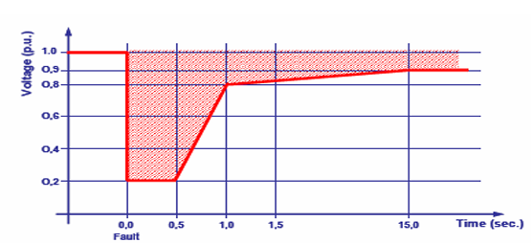
2-i. Withstanding LVRT capability
Wind generators must remain connected during voltage sags (e.g. cleared short circuits)
They shall withstand voltage disturbances even under second-level protection actions
Voltage Profile Recovery of Wind Generators During and After a voltage sag; [1]; (04/10/2025)
[1]

Slide 84
2-i. Withstanding LVRT capability
Wind generators must withstand a 0.5 s voltage dips down to 20% voltage p.u.
Voltage should recover to ≥ 80 % voltage p.u. within 1 s and ≥ 90 % voltage p.u. within 15 s after fault clearance
Wind generators must remain connected during voltage dips of similar or lower severity
They shall recover at least 90 % of pre-fault output within 1 minute
[1]

Slide 85
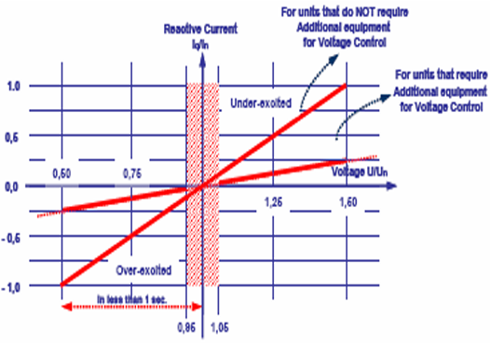
2-ii. Reactive Range & Voltage Control
Dead band of 5 % of nominal voltage is defined for normal operational conditions, with two different allowed operative conditions
Constant Power factor
Participate in Voltage Control
Minimum requirements for a non-synchronous machine in
voltage control; [1]; (04/10/2025)
[1]

Slide 86
2-ii. Reactive Range & Voltage Control
Outside the dead band ability to participate for recovery of voltage
Two different expectations according with the design of non-synchronous machines
Voltage-controlling units: Provide full reactive current (≈ nominal current) for voltages ≤ 50 %; response < 1 s.
Non-voltage-controlling units: Provide up to 25 % capacity (half of nominal to reactive current) via external equipment; response < 1 s
Wind generators must stay connected and stable for voltage variations between 90–110 % of nominal Voltage at the connection point
[1]

Slide 87
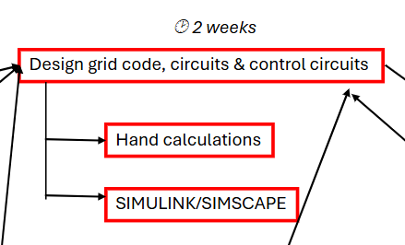
3. Outlook for the coming week

Slide 88
Bibliography – Grid Code Development
[1] SYRRIAN ARAB REPUBLIC / Ministry of Electricity / PETE / Transmission Grid Code, 2014 (accessed Sept. 27, 2025)

Slide 89

Rotor Hub And Pitch System
Group Members :
Dhruvin Kakdiya
Adharsh Pappinisseri Veedu
Muthu Thirunavukarasu
Syed Mohammed Sikandar
Week number : 02
Date: 07/10/2025
Supervisor: Prof. Peter Quell

Slide 90
Agenda
Comparison of Hub shape
Weighted evaluation of a pitch system
Selection of Inner or Outer ring Rotating
07/10/2025 Dhruvin kakdiya Rotor Hub and Pitch System/Optimus syria

Slide 91
Rotor Hub Shape Comparison
Category | Star hub | Sphere hub
Aerodynamic Efficiecy | 2 | 3
Structural simplicity | 3 | 2
Manufacturing ease | 3 | 1
Maintenance access | 3 | 1
Fatigue resistance | 2 | 3
Weight | 3 | 2
Cost | 3 | 1
Suitability(Onshore) | 3 | 1
Sum | 22 | 14
1 = Low preferable, 2 = Medium preferable, 3 = High preferable
07/10/2025 Dhruvin kakdiya Rotor Hub and Pitch System/Optimus syria

Slide 92
Weighted Evaluation of Pitch Control Systems
Criteria | Electrical Pitch | Hydraulic Pitch
Investment cost | 2 | 2
High torque | 3 | 1
Reliability | 3 | 3
Installation | 3 | 1
Operations at Hot climate | 3 | 1
Weight | 3 | 2
Service Friendliness | 3 | 2
Simple Design | 2 | 3
Sum | 22 | 15
1 = Low preferable, 2 = Medium preferable, 3 = High preferable
07/10/2025 Dhruvin kakdiya Rotor Hub and Pitch System/Optimus syria

Slide 93
Why Choose Electric over Hydraulic?
No Hydraulic oil→ no leaks or contamination risk in hot, dusty environment.
Handles high ambient temperatures and dust reliably with IP-rated enclosures.
07/10/2025 Dhruvin kakdiya Rotor Hub and Pitch System/Optimus syria

Slide 94
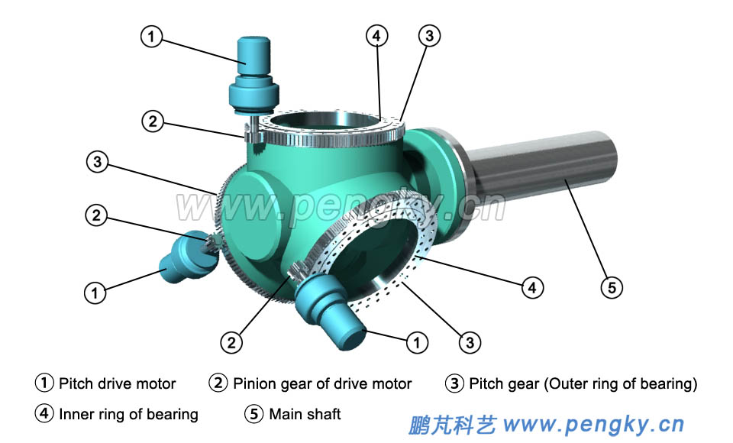
Outer-ring rotating
The blade is bolted to the outer ring and the inner ring is fixed to the hub
07/10/2025 Dhruvin kakdiya Rotor Hub and Pitch System/Optimus syria

Slide 95
Outer ring rotating
Pros
Cons
More compact hub/lighter hub design
Simpler lubrication routing to an inner stationary ring
Higher risk of ring cracking / blade detachment
requires extra protective covers / spinner / teeth covers
07/10/2025 Dhruvin kakdiya Rotor Hub and Pitch System/Optimus syria

Slide 96
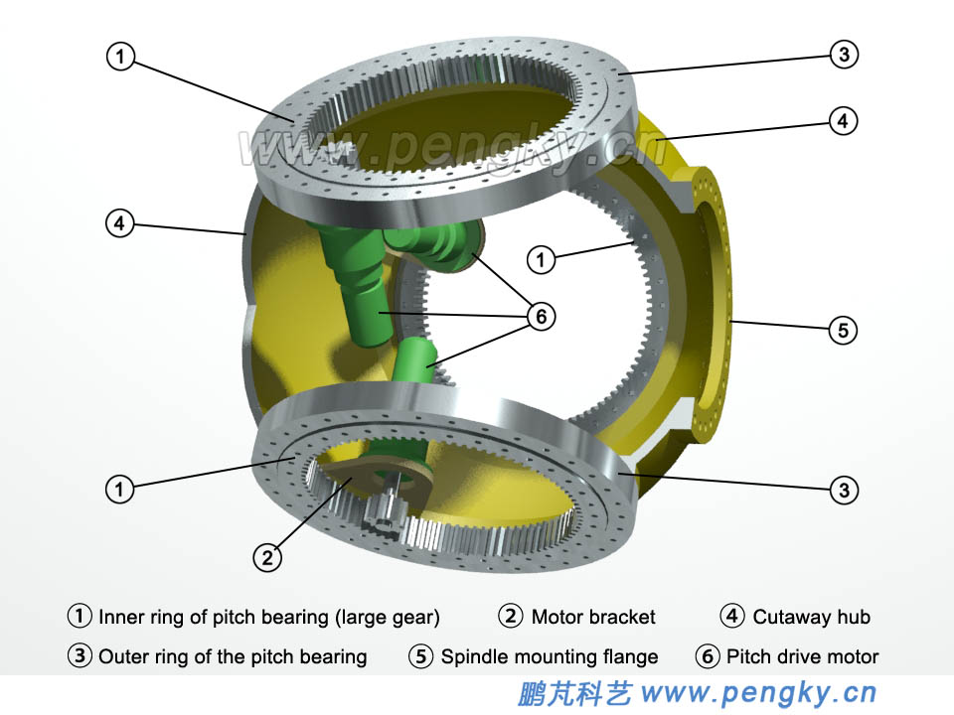
Inner-ring rotating
The blade is bolted to the inner ring and the outer ring is fixed to the hub
07/10/2025 Dhruvin kakdiya Rotor Hub and Pitch System/Optimus syria

Slide 97
Inner ring rotating
Pros
Cons
Safer from blade-detachment viewpoint
Pitch drives can be housed inside the hub ,simplifying environmental protection and maintenance access for the drives.
Can accommodate larger bearing diameter and more rolling elements
Hub may need to be larger to house internal drives and allow for the inner ring geometry
Internal packaging / integration is more complex (electrical routing, motor placement)
07/10/2025 Dhruvin kakdiya Rotor Hub and Pitch System/Optimus syria

Slide 98
Outer-ring and inner-ring rotating
Topic | Outer-ring rotating (blade bolted to outer ring) | Inner-ring rotating (blade bolted to inner ring)
Which ring rotates | Outer ring rotates | Inner ring rotates
Typical pitch drive location | external or on ring perimeter | inside hub
Bearing diameter & element count | Often limited by external packaging | Easier to realize larger pitch
Assembly & maintenance | Blade bolts accessed externally | Blade bolts accessible from inside hub
Common damage modes | Outer ring hoop stresses and through-cracking near bolt holes reported in field cases | Lower incidence outer-ring through-cracks because outer ring is fixed and less stressed
Suitability | Requires reinforced outer ring and protective housings; higher inspection/maintenance attention | Preferred — allows larger diameter bearings, internal drives, improved reliability for high moments typical of 5 MW
07/10/2025 Dhruvin kakdiya Rotor Hub and Pitch System/Optimus syria

Slide 99
Weekly Presentation: Rotor Bearing System
Week number: 02
Date: 07/10/2025
Supervisor: Prof. Quell
Group members: Divyesh Mistry, Venkata Sreekanth .K , Sreehari Padachery, Jill Sadariya
Presenter : Venkata Sreekanth .K
Rotor Bearing System / Optimus Syria

Slide 100
Agenda
Task of the week
Individual responsibility of components
Hydrodynamic vs Hydrostatic
Suggestion for Hydrodynamic bearing
Manufacturing of Shaft
Rotorlocking System
Approached companies & experts
Venkata Sreekanth .K
Rotor Bearing System / Optimus Syria

Slide 101
Task of the week
Divided individual responsibilities of components among team members.
Contacted couple of bearing manufactures and some experts regarding spherical journal bearing suited for 5MW.
Conducted research about the components like rotor lock ,shaft and type of journal bearing.
Venkata Sreekanth .K

Slide 102
Individual responsibility of components
Group Members | Components
Divyesh Mistry & Venkata Sreekanth.k | Rotor Shaft
Jill Sadariya & Sreehari Padachery | Journal Bearing
Jill Sadariya | Rotor Lock
Sreehari Padachery | Bearing Housing
Venkata Sreekanth.k | Coupling
Divyesh Mistry | Flanges
Venkata Sreekanth .K

Slide 103
Hydrodynamic vs Hydrostatic Journal bearing
Feature | Hydrodynamic Bearing | Hydrostatic Bearing
Startup & Low-Speed Operation | High friction | Virtually zero startup friction
Load Carrying Capacity & Stiffness | Depends on rotational speed | Independent of rotational speed.
Maintenance & System Complexity | Mechanically simpler system with fewer components. | More complex system requiring an external pump, filters, piping, and controls
Damping & Vibration Control | Good damping characteristics from the oil film. | Superior damping characteristics, leading to smoother operation and better absorption of vibrations from wind gusts and rotor imbalance.
Cost-Benefit Analysis | Low CAPEX High OPEX | High CAPEX Low OPEX
Venkata Sreekanth .K

Slide 104

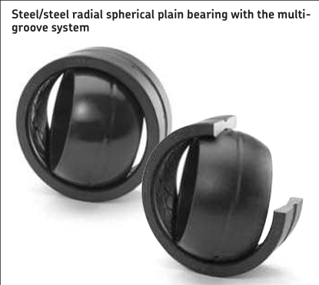
Suggestion for Hydrodynamic bearing
We contacted Howatech Bearings in Germany, and they recommended using a hydrodynamic bearing for the low-speed shaft. For more detailed information, they advised us to get in touch with RENK.
General trend in the wind industry is that Hydrodynamic Journal bearing is used.
Venkata Sreekanth .K

Slide 105
Manufacturing of the Shaft
Forged | Casted
Suitable for cyclic loading, better fatigue behaviour in low-cycle fatigue. | Different cast iron types offer a wide range of property combinations.
Minimizes pores, cavities, and microstructural defects | Volume reduction in low-stress areas can save material, reducing component weight.
Higher strength | can be more brittle
Restricts the shaping of components, limiting design adaptations for specific loading conditions | Suitable for complex shapes and customizations, adaptable to individual loading situations.
Requires higher energy during smelting | Requires less energy for cast iron smelting
Tooling and setup costs can be significant, especially for small production quantities | High damping capacity against vibrations
Material generally used: 42CrMo4 | Material generally used: ductile cast iron EN GJS-400-18-LT and EN GJS-350-22-LT
High Cost of Manufacturing | Low Cost of Manufacturing
Venkata Sreekanth .K

Slide 106
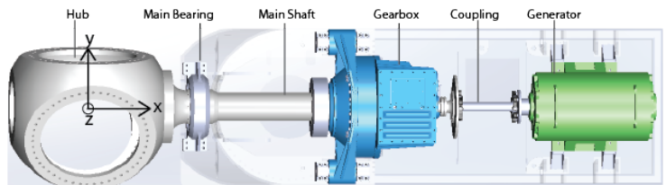
Shaft Dimension
Rotor diameter of the shaft :
Optimus | Rotor diameter | Rotor shaft diameter
Shakti | 178m | 1.4m
60E | 60m | .440m
Syria | 160m | 1.6m
Rotor shaft diameter : +/- 1 or 1.5% of Rotor diameter
By doing some research we assume that the distance between the lever and main bearing should be between 2-3m.
Venkata Sreekanth .K
Rotor Bearing System / Optimus Syria

Slide 107
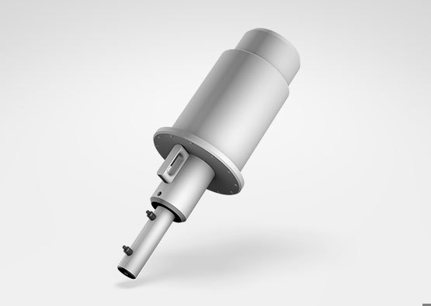
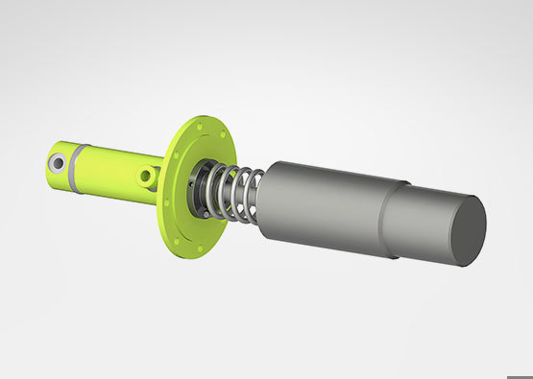
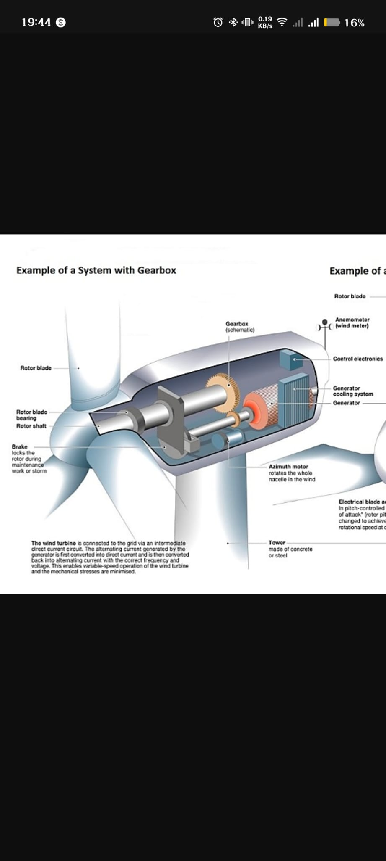
Rotor Locking System
Feature | Hydraulic Caliper Brake with Lock Pin | Purely Mechanical Pin/Ratchet Lock | Gearbox-Integrated Lock
Locking Torque | Very High | Extremely High | High
System Complexity | Moderate to High | Low to Moderate | High
Reliability | Very good | Excellent | Good
Maintenance | Regular inspection required | Simpler maintenance | Difficult
Safety & Redundancy | Excellent | Excellent | Good
Cost | Moderate | Low to Moderate | High
Venkata Sreekanth .K

Slide 108
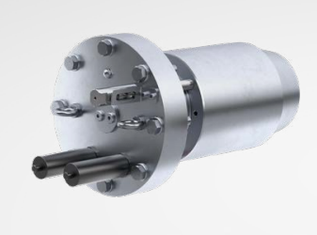
Recommended Rotor Locking System
For a modern 5MW wind turbine, especially in an offshore application, the best and most widely adopted method is the fail-safe Hydraulic Caliper Brake System with an integrated Mechanical Lock Pin.
Reasoning:
Safety through Redundancy: This system provides two crucial functions. The fail-safe brakes can safely stop the rotor in an emergency and hold it, while the mechanical pin offers a secondary, energy-free lock that is essential for ensuring the safety of maintenance crews.
Proven Technology: This approach is mature, well-understood, and has a long track record of reliability in the field.
High Performance: It meets the extreme torque requirements of multi-megawatt turbines and offers powerful dynamic braking, which a purely mechanical lock cannot provide
Venkata Sreekanth .K

Slide 109



Approached companies & experts
Waiting for reply from the following companies
Bearing specialist from Vestas clearly told they cannot share any information regarding Journal bearing due to competion and confidentiality.
Waiting for reply from Fraunhofer IWES and CSC Bearing Europe GmbH.
Venkata Sreekanth .K

Slide 110
Gearbox, Brake, Coupling
Group Members :
Nehang Jitendra Joshi
Santo Mazumder
Md Razaul Karim Rahat
Arham Memon
Week number : 03
Date: 07/10/2025
Supervisor: Prof. Peter Quell

Slide 111
Agenda for 3rd week
Team design
Concept of drive train choice
Basic idea about brake system
Insight about the coupling
Coordinate with internal group--
Rotor hub,Bearing,Machine bed (Mechanical Input)
Electrical Drivetrain Team (Mechanical Output)
Chapter | Responsible person
Introduction | All team members
Project order | All team members
Gearbox | Nehang + Arham
Rotor brake | Rahat+Nehang
Coupling | Santo+Nehang

Slide 112
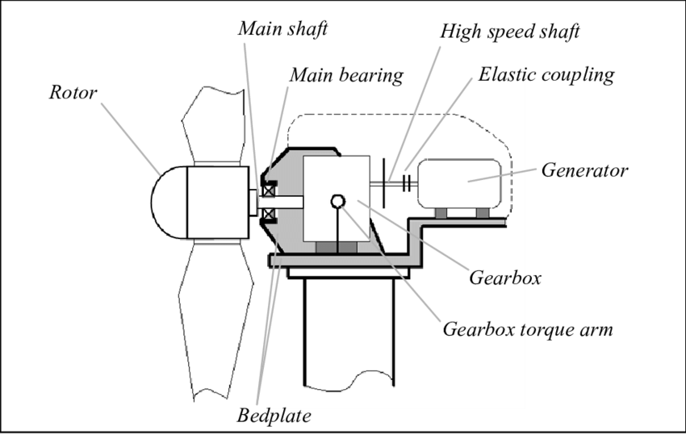

Drive train system
Main Objective:
Break down analysis of 3-Point suspension concept for each criteria of selection
Source-https://www.researchgate.net/

Slide 113
3-Point suspension
Paired comparison analysis for drive train
Criteria of drive train | 4Point suspension Modular | 3point suspension Semi-integrated | Integrated | hybrid | Direct drive
Low capex | 1 | 3 | 2 | 1 | 1
High serviceability | 3 | 3 | 1 | 1 | 1
Easy to assemble | 2 | 3 | 3 | 3 | 2
Availability of spear parts | 3 | 3 | 1 | 1 | 1
Light weight | 1 | 2 | 3 | 2 | 3
Transport | 3 | 3 | 1 | 1 | 2
Reliability | 1 | 2 | 2 | 2 | 3
Total Points
4Point suspension Modular --- 14
3point suspension Semi-integrated-- 19
Integrated-- 13
Hybrid-- 11
Direct drive-- 13

Slide 114
Criteria of drive train | 4Point suspension Modular | 3point suspension Semi-integrated | Integrated | hybrid | Direct drive
Low capex | High cost due to complexity, additional materials. | fewer components and simpler geometry | omplex design, tooling, and manufacturing | depends on how the hybrid is implemented. Can reduce cost through smart design | precision motor design and electronics needed.
High serviceability | More moving parts mean more maintenance | due to simplicity and fewer joints | difficult to access internal components without specialized tools | some parts are easy to fix, others not | fewer moving parts, but harder to repair motor if it fails
Easy to assemble | Requires precise alignment and more components to mount | often DIY-friendly | often assembled in factory only | custom instructions, especially if parts are not standardized | no chain or transmission
Availability of spear parts | especially in mainstream markets | due to standardization | harder to source and replace | some parts standard, others proprietary | specially if proprietary motor is used.
Light weight | due to extra linkages and hardware | design is a major benefit | helps reduce external mounts and improves aerodynamics | depending on materials and structure. | due to fewer mechanical parts
Transport | may require partial disassembly for shipping | better for packaging or folding designs | more fragile due to enclosed systems | some parts may be detachable, others fixed. | fewer parts means easier logistics
Reliability | especially in demanding terrain or under load. Built for durability | but may not perform well under heavy stress or rough terrain | components are protected from the elements. Risky if one part fails | if well-engineered – benefits from best of both worlds | no wear on chains/gears, fewer failure points.

Slide 115
Gearbox system
Main Objective:
Break down analysis of planetary gearbox concept for each criteria of selection.
Criteria Key Points for Planetary Gearbox.

Slide 116


Gearbox system
Source- Planetary System gears by SMC
Manufactures

Slide 117
Gearbox system
Criteria Key Points for Planetary Gearbox
Design -Compact, multiple gear ratios, load sharing, low backlash possible
Manufacturing-Precision machining, heat treatment, quality materials, tight tolerances
Space Requirement-Very compact for torque output; coaxial design saves space
Weight- High torque-to-weight ratio; lightweight options available
Efficiency- High (95–98%), optimized by quality gears and lubrication
Reliability -Excellent with proper design and maintenance; robust against heavy-duty use

Slide 118
Rotor Brake
Main Objective:
Break down analysis of Rotor brake.
Criteria Disc Brake System.

Slide 119

Rotor Brake
Source- KTG AUTO

Slide 120

Rotor Brake
Source- KTG AUTO

Slide 121
Rotor Brake
Criteria Disc Brake System-
Design-Simple, open design with rotor, caliper, and pads. Good for cooling and modularity.
Manufacturing- Mature process; rotor and caliper materials vary with performance level.
Space Requirement-Compact design, but performance setups need larger wheels and calipers.
Performance & Pressure-Excellent braking, quick heat dissipation, linear pressure response.
Weight- Moderate; lighter than drums at high end, but heavier at low cost.
Maintenance & Reliability- Easy access, frequent pad changes, prone to corrosion/warping.
Cost- Affordable for mass production; premium for high-performance materials.

Slide 122
Coupling
Main Objective:
Break down analysis of Coupling
Criteria Coupling

Slide 123

Coupling

Slide 124
Coupling
Criteria Disc Brake System-
Design-Compact, torsionally rigid, high misalignment capability
Protection-Requires external guards; corrosion-resistant options available
Efficiency--Very high (>99%), no backlash, no lubrication needed
Service & Maintenance- Low; visual inspection and alignment checks sufficient
Reliability & Weight-Very reliable, lightweight, fatigue-resistant
Cost-High upfront cost, low over time due to durability

Slide 125
Bibliography
https://www.twiflex.com/en/newsroom/2016/02/is-caliper-brake-solutions-for-wind-turbines
https://antec-group.com/wp-content/uploads/2021/12/Catalogo-Wind-2022.pdf
https://www.twiflex.com/en/newsroom/2016/02/is-caliper-brake-solutions-for-wind-turbines
https://www.windsourcing.com/en/spare-parts-and-repair-material/brakes/brake-calipers/
https://www.ktr.com/de/en/products/brake-systems/
https://www.zf.com/products/en/wind/home/wind.html#:~:text=Empowering%20a%20Sustainable%20Future%20Together&text=ZF%20Wind%20Power%20develops%2C%20together,future%20together%20with%20our%20partners.
https://www.flender.com/en/branchesAndApplications/winergy#:~:text=Two%20powerful%20brands%20%2D%20one%20company,wind%20for%20a%20better%20future.

Slide 126
Weekly report: Machine Bed & Yaw System
Week # 2
Date: 07/10/2025
Supervisor: Prof. Quell Peter
Group members: Shoukat Abbas, Luksh Chawla, Sathishkumar Venkatachalam, Shrihari Kadam
Flensburg University of Applied Sciences

Slide 127
Contents
Reference Models For Bed plate - 5MW with 4-point support
Reference Models For Bed plate - 5MW with Separated Bed plate
Reference Models from Optimus Sakthi
Coordinate system & load definitions (IEC)
Axial Load and Radial load Comparison
About NGC Group
Reference
Shoukat Abbas, Luksh Chawla, Sathishkumar Venkatachalam, Shrihari Kadam

Slide 128

Reference Models For Bed plate - 5MW with 4 point support
Credits: Norwegian University of Science and Technology - Dr. Jason Jonkman, Prof. Erin Bachynski-polic Source: [2]
Shoukat Abbas, Luksh Chawla, Sathishkumar Venkatachalam, Shrihari Kadam

Slide 129

Reference Models For Bed plate - 5MW with 4 point support
1. Models are Same, Changes in Design
2. Design Changes in Tail Area, Addition of casting material.
3. Ribs and Cost cuttings are Added - For stability and reduction of Material Weight & cost.
Shoukat Abbas, Luksh Chawla, Sathishkumar Venkatachalam, Shrihari Kadam

Slide 130




Reference Models For Bed plate - 5MW with Seperated Bed plate
Source : https://www.mdpi.com/1996-1073/14/12/3581?utm_source [3]
Shoukat Abbas, Luksh Chawla, Sathishkumar Venkatachalam, Shrihari Kadam

Slide 131



Reference Models from Optimus Sakthi
Shoukat Abbas, Luksh Chawla, Sathishkumar Venkatachalam, Shrihari Kadam

Slide 132
For Optimus Syria - What do we decide at the moment to go for in Design?
Bed type:
Go for Casting
Material:
Grey Cast Iron (EN-GJL-250 (GG25)
Price as per market - 2.8 to 3.2 Euro / Kg
Max. Weight of a Machine Bed:
15 to 22 tons ( For 5MW turbine)
Single frame Design, may be changed into separate in the future (If needed)
Shoukat Abbas, Luksh Chawla, Sathishkumar Venkatachalam, Shrihari Kadam

Slide 133
Coordinate system & load definitions (IEC)
Blade-root coordinates:
X = Thrust (along shaft)
Y = vertical radial / flapwise (along y)
Z = lateral / side to side (along z)
Hub / Nacelle coordinates:
Fx = axial force, Mx is rotor torque moment (about x)
Fy = radial (vertical), My = tilting moment (about y)
Fz = lateral force, Mz = yaw moment (about z)
Fig: Global blade coordinate system [1]
133

Slide 134


Axial Load and Radial load Comparison
Formula:
$$F_{Axial Syria}=F_{axial Shakti}×{\left(\frac{D_{Syria}}{D_{Shakti}}\right)}^{2}$$
Shakti diameter: 174 m
Syria diameter: 160 m
Scaling factor = (160 / 174)² ≈ 0.845
Case 1: Shakti axial = 700 kN → Syria axial ≈ 700 × 0.845 = 592 kN
Case 2: Shakti axial = 900 kN → Syria axial ≈ 900 × 0.845 = 761 kN
Case 1: Shakti radial = 800 kN → Syria radial ≈ 800 × 0.845 = 676 kN
Case 2: Shakti lateral = 2000 kN → Syria lateral ≈ 2000 × 0.845 = 1690 kN
134

Slide 135


Nanjing High Accurate Drive Equipment Mfg Group Co., Ltd. (NGC Group)
Multi-megawatt pitch gearboxes and yaw drives wind turbines.
With more than 20 years of experience in the wind energy field
Product Features
Torque: 10 kNm - 250 kNm
Wind turbine power: 1x MW - 15 MW
High bearing capacity
High reliability and efficiency
Compact design
Applications
Onshore & offshore
Low & high-altitude areas (> 1000 m)
Low & high temperature environments (-40 °C to + 50 °C)
Low wind speeds
135

Slide 136
References
[1] P. N. Castelos, “On the impact of multi-axial stress states on trailing edge bondlines in wind turbine rotor blades,” https://www.researchgate.net, Oct. 2016. https://www.researchgate.net/publication/308793459_On_the_impact_of_multi-axial_stress_states_on_trailing_edge_bondlines_in_wind_turbine_rotor_blades
[2] V. Liverud, J. Jonkman, and Bachynski-Polić, “Drivetrain structural flexibility in OpenFAST.” Accessed: Oct. 06, 2025. [Online]. Available: https://www.sintef.no/globalassets/project/eera-deepwind-2023/presentasjoner/substructures_krathe.pdf?utm_source
[3] A. S. Pehlivan, M. F. Aksit, and K. Erbatur, “Fatigue Analysis Design Approach, Manufacturing and Implementation of a 500 kW Wind Turbine Main Load Frame,” Energies, vol. 14, no. 12, p. 3581, Jun. 2021, doi: https://doi.org/10.3390/en14123581.
136

Slide 137
Weekly report: Tower structure
Week number: 02
Date: 06/10/2025
Supervisor: Prof. Faber
Group members: Ibrahim Mostafa, Mohammed Eldemerdash, Kirolls Ghaly
Speaker: Ibrahim Mostafa(770134)

Slide 138
List of contents
Selecting Suitable Dimensions for the Tower
Group members: Ibrahim Mostafa, Mohammed Eldemerdash, Kirolls Ghaly
Tower structure team/ Optimus Syria

Slide 139

1-Tubular Steel tower system primary design
Tubular steel tower for Siemens
Group members: Ibrahim Mostafa, Mohammed Eldemerdash, Kirolls Ghaly
Tower structure team/ Optimus Syria

Slide 140

Loads calculations and stress analysis
Fig 9: how the different loads and moments affect the wind turbine
Group members: Ibrahim Mostafa, Mohammed Eldemerdash, Kirolls Ghaly
Tower structure team/ Optimus Syria

Slide 141
Loads calculations and stress analysis
Assumptions
𝜌_{air}=1.225 kg/m³
𝜌_{steel}=7850 kg/m³
(Wind class III) 𝑉=37.5 m/s
𝑔=10 m/s²
𝐷_{rotor}=160 m, 𝐷_{𝑜}=6.0 m, 𝑡=0.027 m
⇒ 𝐷_{𝑖}=5.946
𝐻_{tower}=98 m
ℎ_{hub}=100 m
𝐶_{𝑇}=0.5
𝐶_{𝐷}=1 ​
𝑚_{rotor}=110,000 kg
𝑚_{nacelle}=240,000 kg
𝑚_{RNA}=350,000 kg
𝑀_{nacelle}=4200 kN
Reference to data assumptions:
https://www.nrel.gov/wind/data-tools
Group members: Ibrahim Mostafa, Mohammed Eldemerdash, Kirolls Ghaly
Tower structure team/ Optimus Syria

Slide 142

Loads calculations and stress analysis
Group members: Ibrahim Mostafa, Mohammed Eldemerdash, Kirolls Ghaly
Tower structure team/ Optimus Syria

Slide 143


Loads calculations and stress analysis
Group members: Ibrahim Mostafa, Mohammed Eldemerdash, Kirolls Ghaly
Tower structure team/ Optimus Syria

Slide 144

2. Tubular steel tower with tie system, primary design.
Assumptions
𝜌_{air}=1.225 kg/m³
𝜌_{steel}=7850 kg/m³
(Wind class III) 𝑉=37.5 m/s
𝑔=10 m/s²
𝐷_{rotor}=160 m, 𝐷_{𝑜}=9.0 m, 𝑡=0.027 m
⇒ 𝐷_{𝑖}=8.946
𝐻_{tower}=98 m
ℎ_{hub}=100 m
Group members: Ibrahim Mostafa, Mohammed Eldemerdash, Kirolls Ghaly
Tower structure team/ Optimus Syria

Slide 145

2. Tubular steel tower with tie system, primary design.
Group members: Ibrahim Mostafa, Mohammed Eldemerdash, Kirolls Ghaly
Tower structure team/ Optimus Syria

Slide 146

2. Tubular steel tower with tie system, primary design.
Group members: Ibrahim Mostafa, Mohammed Eldemerdash, Kirolls Ghaly
Tower structure team/ Optimus Syria

Slide 147

2. Tubular steel tower with tie system, primary design.
Group members: Ibrahim Mostafa, Mohammed Eldemerdash, Kirolls Ghaly
Tower structure team/ Optimus Syria

Slide 148

2. Tubular steel tower with tie system, primary design.
Group members: Ibrahim Mostafa, Mohammed Eldemerdash, Kirolls Ghaly
Tower structure team/ Optimus Syria

Slide 149

Loads calculations and stress analysis
Group members: Ibrahim Mostafa, Mohammed Eldemerdash, Kirolls Ghaly
Tower structure team/ Optimus Syria

Slide 150

Loads calculations and stress analysis
Group members: Ibrahim Mostafa, Mohammed Eldemerdash, Kirolls Ghaly
Tower structure team/ Optimus Syria

Slide 151


Loads calculations and stress analysis
Fig : Original handwritten calculations
Group members: Ibrahim Mostafa, Mohammed Eldemerdash, Kirolls Ghaly
Tower structure team/ Optimus Syria

Slide 152
work distribution
Mohammed Eldemerdash:
Searching for the wind loads in IEC 61400-1 code .
Ibrahim Mostafa:
Load calculations and primary design.
Kirollos Ghaly:
- no input
Group members: Ibrahim Mostafa, Mohammed Eldemerdash, Kirolls Ghaly
Tower structure team/ Optimus Syria

Slide 153
Weekly report: Foundations
Week number: 03
Date: 07/10/2025
Supervisor: Prof. Dr.-Ing. Torsten Faber
Group members : Jehad Albaali- Amgad Gerges - Reda Deif
presented by : Amgad Gerges

Slide 154
List of contents
Soil Profile for Qattinah .
Soil Properties for Qattinah
`Choose Type of Foundations .
Group members: Jehad Albaali- Amgad Gerges - Reda Deif
Foundations team/ Optimus Syria

Slide 155

Soil Profile for Qattinah
https://soilgrids.org/?utm
https://earth.google.com/web/search/34%c2%b041%2749.6%22N+36%c2%b030%2730.0%22E/@34.67531382,36.5 980701,506.39690821a,3513.70885844d,35y,360h,0t,0r/data=CiwiJgokCTkQ2iOXWkFAEQndzvkBWEFAGYw3RwMnRE JAIQJ6D_SHPUJAQgIIAUICCABKCAjMjOyYBRAA
Group members: Jehad Albaali- Amgad Gerges - Reda Deif
Foundations team/ Optimus Syria

Slide 156
Soil Properties for Qattinah
Depth | Soil Type | Moduls of Elasticity | Friction Angle | Cohesion | Density | Poisson Ratio
(m) |  | KN/m² | [°] | KN/m² | KN/m³
0 - 18 | Soft to medium clay (CL / CL–OL) | 7000 | 20º | 15 | 18 | 0.45
18 - 45 | Medium cohesive clay | 11,000 | 22º | 20 | 19 | 0.45
45 – 80 | Stiff to very stiff clay (CL–CH) | 20,000 | 24º | 25 | 20 | 0.45
80 – 100 | Very stiff clay | 25,000 | 26º | 30 | 21 | 0.40
https://soilgrids.org/?utm
Group members: Jehad Albaali- Amgad Gerges - Reda Deif
Foundations team/ Optimus Syria

Slide 157

Choose Type of Foundations
The estimated type of foundation for our turbine will be shallow foundation type (mat with round shape)
Reasons for estimated shallow foundation type
More effective cost than deep foundation
Simple and Fast to Construct
we don’t need specialized equipment , which reduces construction time and cost
ground water is at depth 74.5 m so it will not be affected by ground water.
Reasons for estimated round shape type
Uniform Load and Moment Distribution
Smaller Perimeter for the Same Area ( amount of concrete and steel Rebar decrease )
: http://ggis.un-igrac.org/
Group members: Jehad Albaali- Amgad Gerges - Reda Deif
Foundations team/ Optimus Syria

Slide 158
Next Task
Estimation of Concrete Dimensions depending on estimations loads
Estimation Weight of foundation
Group members: Jehad Albaali- Amgad Gerges - Reda Deif
Foundations team/ Optimus Syria

Slide 159


Weekly report: Storage System
Week number: 02
Date: 07/010/2025
Supervisor: Dr. Laurence Alhrshy
Group members: Mohamed Ahmed

Slide 160

Battery Technologies for Large-Scale Energy Storage
Content
Introduction
Lithium-Ion Batteries
Sodium-Sulfur Batteries
Flow Batteries
Comparative Summary Table
Technology Selection for Our Project
Conclusion

Slide 161
Introduction
Energy storage lies at the core of the renewable energy revolution. As the world shifts toward clean and sustainable power, batteries have become essential for balancing supply and demand.
In this presentation, we will explore the main battery technologies used for large-scale energy storage, highlighting their advantages, disadvantages, costs, and leading manufacturers. Finally, based on our analysis, we will identify the most suitable battery type for our project.

Slide 162
Lithium-Ion Batteries Lithium-Ion Batteries: Pros & Cons
Cons | Pros
High Cost: More expensive upfront compared to other battery types | High Energy Density: Stores a large amount of energy in a compact, lightweight form (150–200 Wh/kg).
Limited Lifespan: Capacity gradually decreases (~20% loss after 500 cycles) | Long Cycle Life: Can last several years with over 1,000 charge–discharge cycles.
Safety Risks: Risk of thermal runaway, requiring careful handling. | Fast Charging: Allows quick recharge with new fast-charging technologies.
Environmental Impact: Mining and disposal affect sustainability. | Low Self-Discharge: Retains charge well (only 2–3% loss per month).
Temperature Sensitivity: Performance drops in extreme temperature. | Variety of Sizes and Shapes: Flexible design for multiple applications.

Slide 163
Sodium-Sulfur Batteries
Sodium-Sulfur Batteries: Pros & Cons
Disadvantages | Advantages
Operates at high temperatures (300–350°C) | High energy density (~150 Wh/kg)
Safety risks due to molten sodium and sulfur | Long cycle life (1000–2000 cycles)
Large size and heavy weight | High charge/discharge efficiency (89–92%)
Shuttle effect can reduce capacity and performance | Relatively low cost per unit energy
Poor performance at room temperature | Compatible with renewable energy storage

Slide 164

Flow Batteries
Flow Battery Technologies: RFBs have been investigated and produced during the past few decades using various chemistries. Among them the commercialized deployment of all vanadium RFB began in the 1980s.
Main types of Flow Batteries
All-Vanadium Redox Flow Battery (VRFB)
Zinc–Bromine Flow Battery (ZBFB)
Iron–Chromium Flow Battery (Fe–CrFB)
Aqueous Organic Redox Flow Battery (AORFB)
Metal–Air Flow Battery (MAFB)
Semi-Solid Flow Battery (SSFB)
Solar Redox Flow Battery (SRFB)
Solid-Mediated Flow Battery (SMFB)

Slide 165
Flow Batteries
Flow Batteries: Pros & Cons
Disadvantages | Advantages
Low energy/power density | Very low stand-by loss (almost no self-discharge)
High capital cost, especially membranes ($200–600/m²; new membranes ~$50/m²) | Stable performance regardless of power demand
Requires technological improvements for industrial applications | Long cycle life (≥2000 cycles on average; some >10,000)
Need for optimized cell design to reduce ohmic and activation losses | Electrodes remain chemically and physically stable
Complex system structure (separate tanks, flow fields) | High safety and recyclability

Slide 166
Costs & Leading Manufacturers
Leading Manufacturers | Costs | Types
China-based CATL and BYD, South Korean companies ,like LG and Samsung SDI, and Japan-based Panasonic. Other notable players are the US-based Tesla Gigafactories and several prominent companies in China, such as Tianneng Group and Microvast. | about $151 per kWh | Lithium-Ion Batteries
Infinite Energy Systems (UK) Sumitomo Electric Industries, Ltd. (Japan) VRB Energy (Canada) Enerox GmbH (Austria) Elestor (The Netherlands) ESS Tech, Inc. (US) Largo Inc. (Canada) Lockheed Martin Corporation (US) Primus Power (US) | $260–$500 per kWh (The price varies depending on the type) | Flow Batteries
NGK Insulators Ltd.,EaglePicher Technologies LLC,GE Energy Storage,BYD Company Limited,Furukawa Battery Co., Ltd.,Amara Raja Batteries Ltd.,Samsung SDI Co., Ltd. EnerVault Corporation,Ceramatec, Inc.,Sieyuan Electric Co., Ltd. | $300–$450 per kWh | Sodium-Sulfur Batteries

Slide 167
Technology Selection for Our Project
Project Conditions:
The wind turbine is IEC Class 3A with a 160 m rotor diameter, indicating high capacity and variable generation.
The system requires medium to long-term energy storage (several hours) to balance wind fluctuations.
Project space is not highly constrained, allowing installation of a large-scale Flow Battery system.
Safety and long lifespan are prioritized over high energy density.
Final Selection: Vanadium Redox Flow Battery is Most suitable for large-scale wind applications, providing long-duration storage, stable performance, and extended operational lifetime.
Hybrid Energy Storage System (HESS): Flow Battery: For long-duration energy storage (hours). Li-ion Battery: For fast response and frequency regulation.

Slide 168
Technology Selection for Our Project
Enerox / CellCube (Austria / The CellCube family) Why?
European manufacturing — high quality and reliable production standards.
Geographical proximity (Europe → Middle East) — easier logistics and shorter delivery times.
Proven operational track record — numerous successful systems deployed across Europe.
Strong commercial experience — established projects and long-term clients
Easy communication and support — accessible and responsive European supplier

Slide 169
References
https://www.battery.associates/post/state-of-art-of-flow-batteries-a-brief-overview
https://bslbatt.com/blogs/lithium-battery-price-2025-current-costs-trends-and-changes/
https://www.sciencedirect.com/science/article/pii/S0306261924003374
https://www.skyquestt.com/report/sodium-sulfur-battery-market/companies
https://www.sciencedirect.com/topics/engineering/sodium-sulfur-battery#:~:text=Sodium%E2%80%93sulfur%20batteries%20offer%20long%20battery%20lifetime%20(up,its%20explosiveness%20have%20constrained%20its%20wide%2Dscale%20implementation.

